Slide 2
Campus Representative Portal
Training Document

Slide 3
Campus Representative Program Overview
Campus Representatives are faculty or staff willing to assist interested and eligible students with navigating the Undergraduate Transfer Scholarship application process.
Cooke Foundation Staff collaborate with Campus Reps to facilitate outreach on their campuses and provide additional support regarding application completion.
Scholarship recipient notifications are released to Campus Reps before applicants.
Some campuses plan surprise celebrations to recognize their recipients.

Slide 4
Before We Begin
All Campus Representatives must complete the User Agreement Form prior to accessing the portal.
https://apply.jkcf.org/register/externaluseragreement
To protect student information, the portal will only be available to those who are registered with the Foundation as Campus Representatives. Please click here to update your preferences.

Slide 5
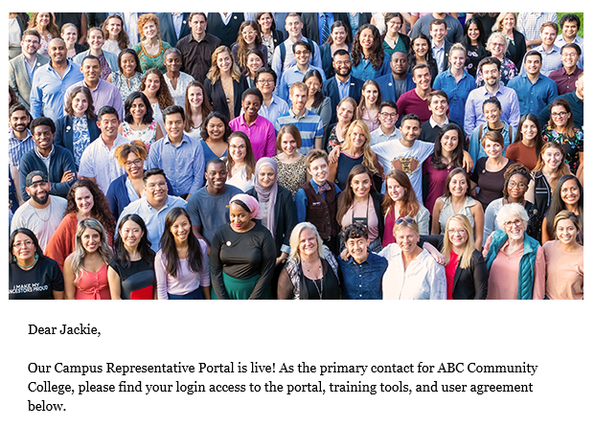
Portal Login
Please review the email sent for your username and temporary password information.
After submitting the User Agreement Form, you will receive an email with a link to the portal
Username: your email address
Password: temporarily assigned to you, then you will create your personal password
Please email zcampion@jkcf.org with any password issues

Slide 6
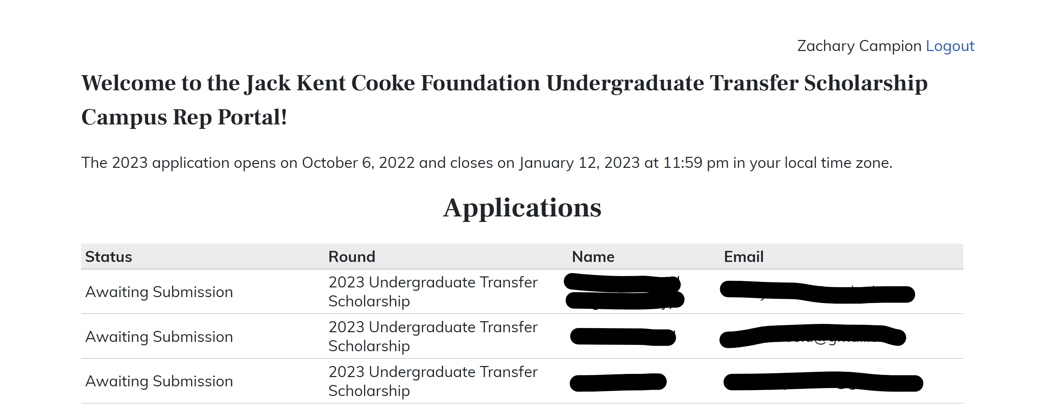
Portal Home Page
Your name here
Applicant Name
Applicant Email
Applicant Name
Applicant Email
Applicant Name
Applicant Email

Slide 7
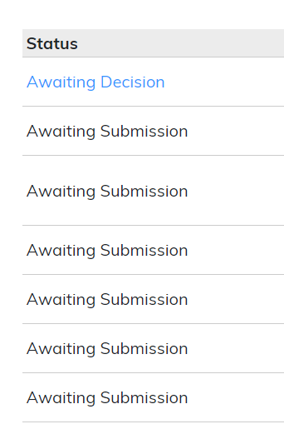
Application Status
Awaiting Decision: student has submitted Common App for Transfer, two recommendation letters, resume, and transcript. This is a complete application.
Awaiting Materials: student has submitted Common App for Transfer but is missing supplemental materials (rec letters, resume, and/or transcript)
Awaiting Submission: student has not submitted Common App for Transfer

Slide 8
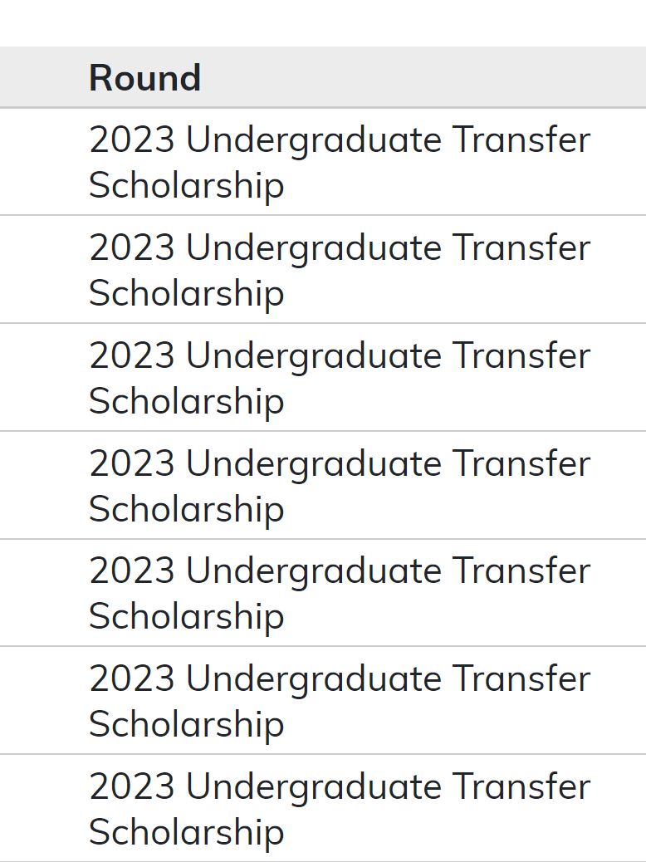
Application Round
All applicant rows should display the 2023 Undergraduate Transfer Scholarship, indicating they are applying for the application that is currently open.
The application opened on October 6, 2022 and will close on January 12, 2023.

Slide 9
Student Contact Information
This portal provides the names and email addresses of applicants on your campus.
You may copy email addresses from the portal and paste in Excel sheets to send bulk emails to your students. You may also connect individually.
Please be aware students may have used a personal email address rather than a school-provided email address to create their Common App for Transfer account.

Slide 10
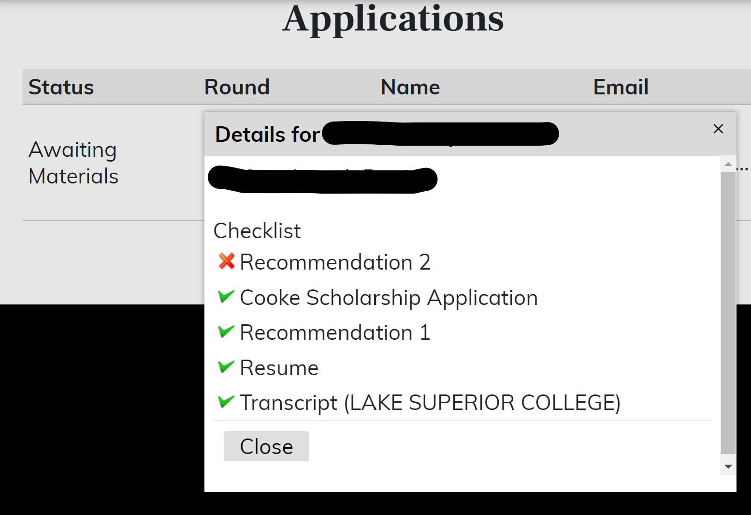
Checklist Pop-ups
Click on each row to view a checklist specific to your student’s application.
*Student names have been redacted here for privacy

Slide 11
Troubleshooting
If you know a student who intends to apply but their name is not listed in your portal, check with them about the following items:
Have they added the Jack Kent Cooke Foundation program to their Common App for Transfer?
Have they included a different campus in their coursework information? It is possible they are listed under that college’s portal and not yours. Contact Zach at zcampion@jkcf.org if needed.

Slide 12
Additional Help
Questions about the Common App for Transfer
https://help.liaisonedu.com/The_Common_App_Help_Center
thecommonapplication@liaisoncas.com
Response time: 1-2 business days, 3 days during busiest times
Questions about the Program and Eligibility
www.jkcf.org/transfer
scholarships@jkcf.org
Response time: 1-2 business days, 3 days during busiest times

Slide 13
Key Dates
Application opens:
October 6, 2022
Application closes:
January 12, 2023
Semifinalists announced:
March 2023
Recipients announced:
April 2023

Slide 14
Thank you!
Follow @TheJKCF

