Slide 1

The Cooke Young Scholars Program
Application Period: February 5 – April 29, 2026

Slide 2
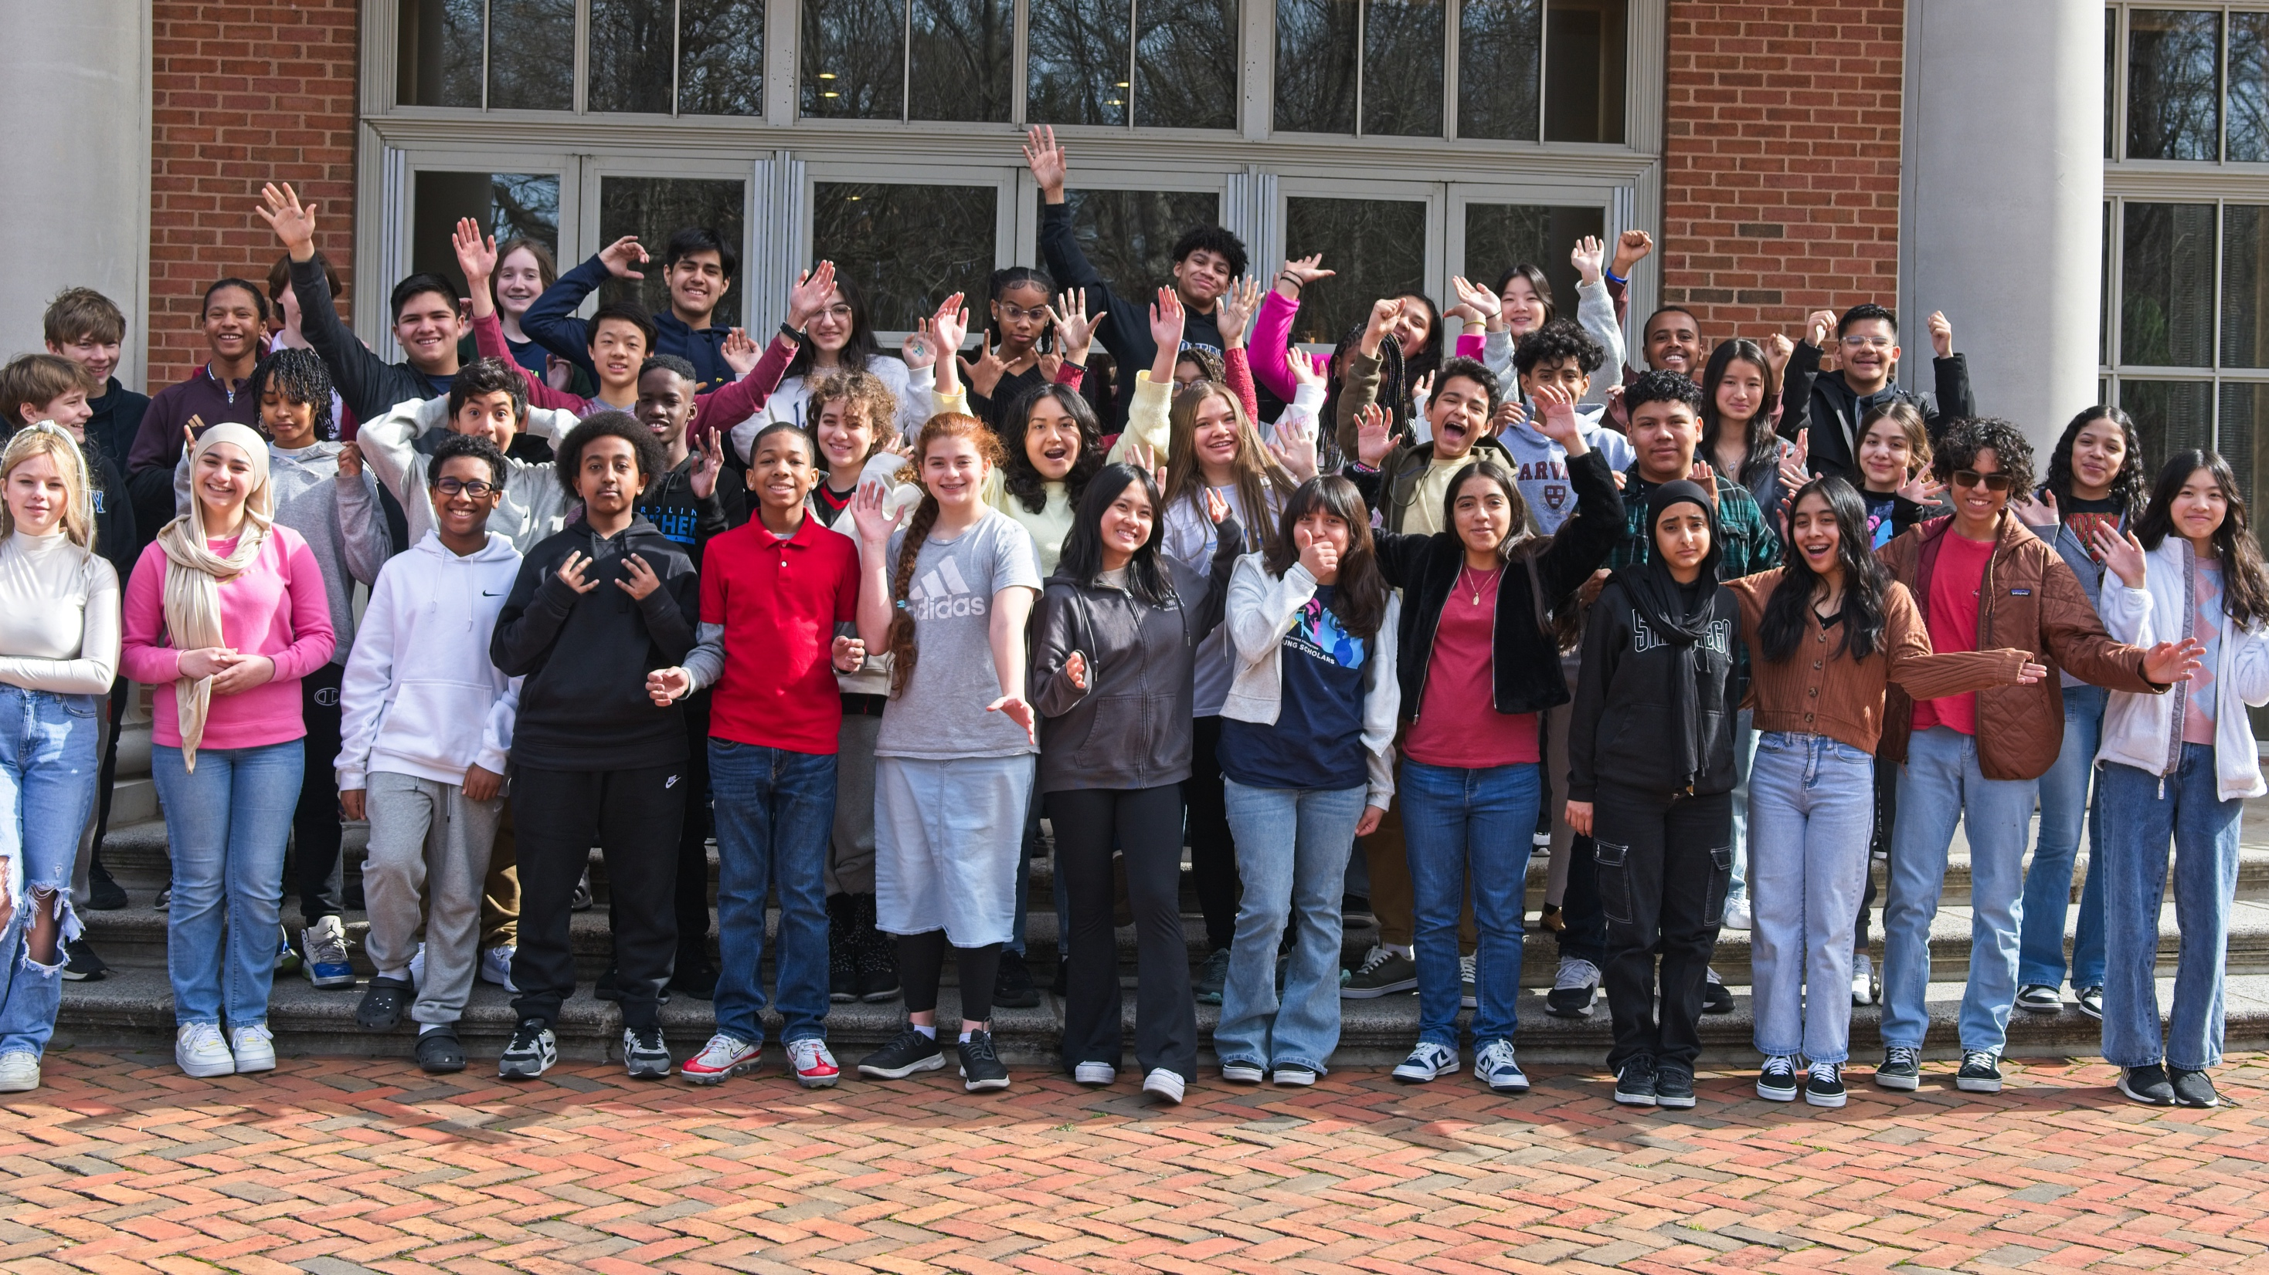
COOKE YOUNG SCHOLARS PROGRAM

Slide 3

Selective five-year, pre-college scholarship
Exceptionally promising 7th grade students with financial need
Benefits:
Comprehensive academic and college advising
Financial support for school, Cooke-sponsored summer programs, internships, and other learning enrichment opportunities

Slide 4

YOUNG SCHOLAR PROGRAM EXPERIENCE

Slide 5
As a Young Scholar, you will:
DEVELOP YOUR TALENTS
ENGAGE AND LEAD PURPOSEFULLY
CONTRIBUTE TO THE WORLD
CARE FOR YOURSELF
CONNECT WITH PEOPLE
OWN YOUR LEARNING

Slide 6
ELIGIBILITY: WHO CAN APPLY
ACADEMICS:
Earned mostly As in core academic subjects since 6th grade
LOCATION:
Currently in middle school in the U.S. and planning to attend high school in the U.S.
GRADE LEVEL: Currently in 7th grade and/or entering 8th grade in fall 2026
FINANCIAL NEED: Median family income for last year’s cohort was $49,000

Slide 7


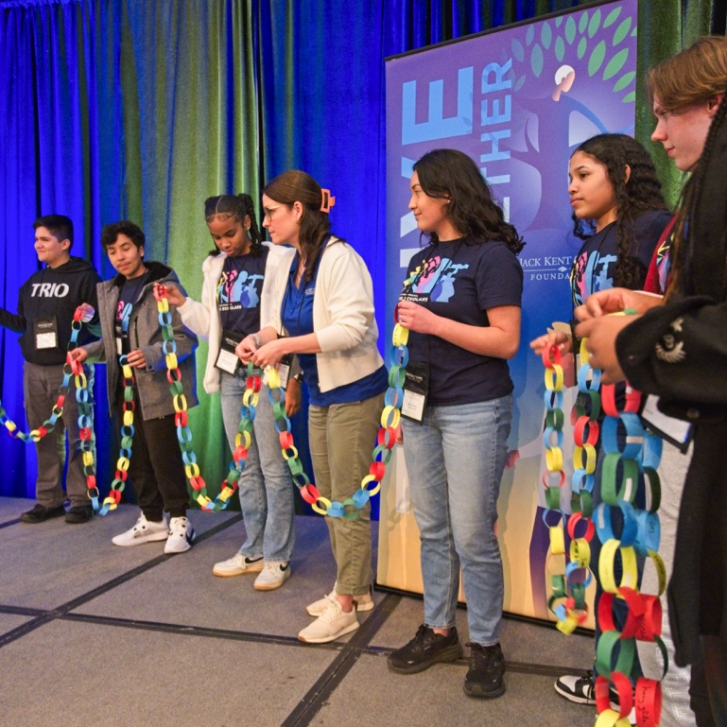
YOUNG SCHOLAR COMMUNITY

Slide 8

QUESTIONS?

Slide 9
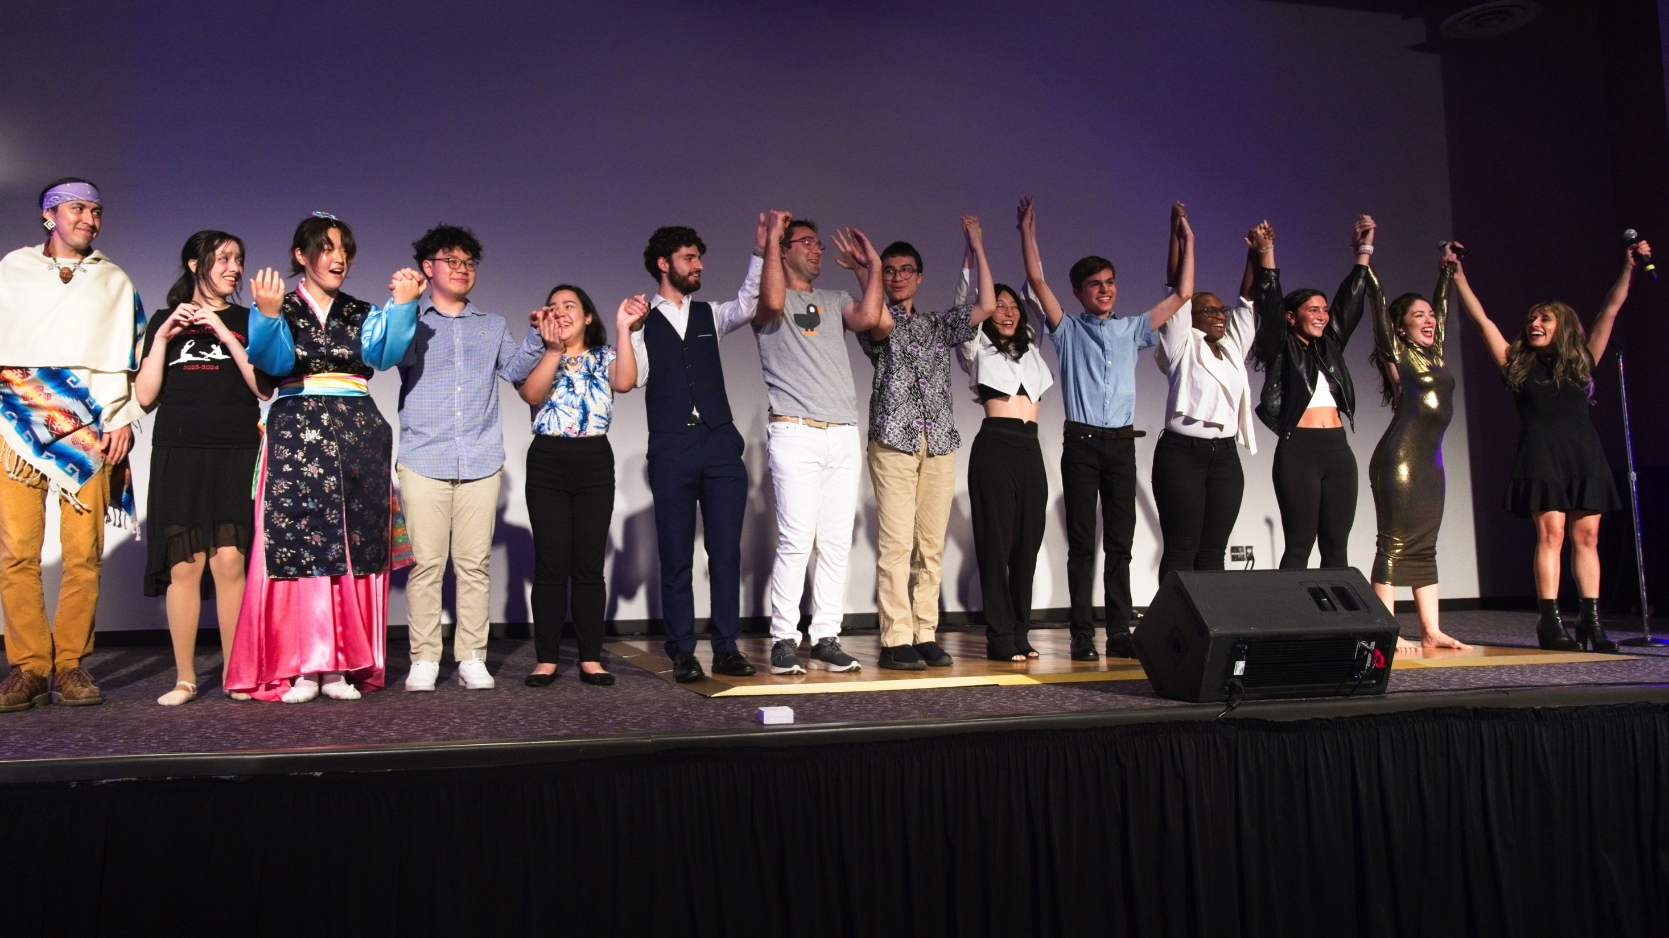
THANK YOU!

