Slide 1
The Cooke Undergraduate Transfer Scholarship

Slide 2
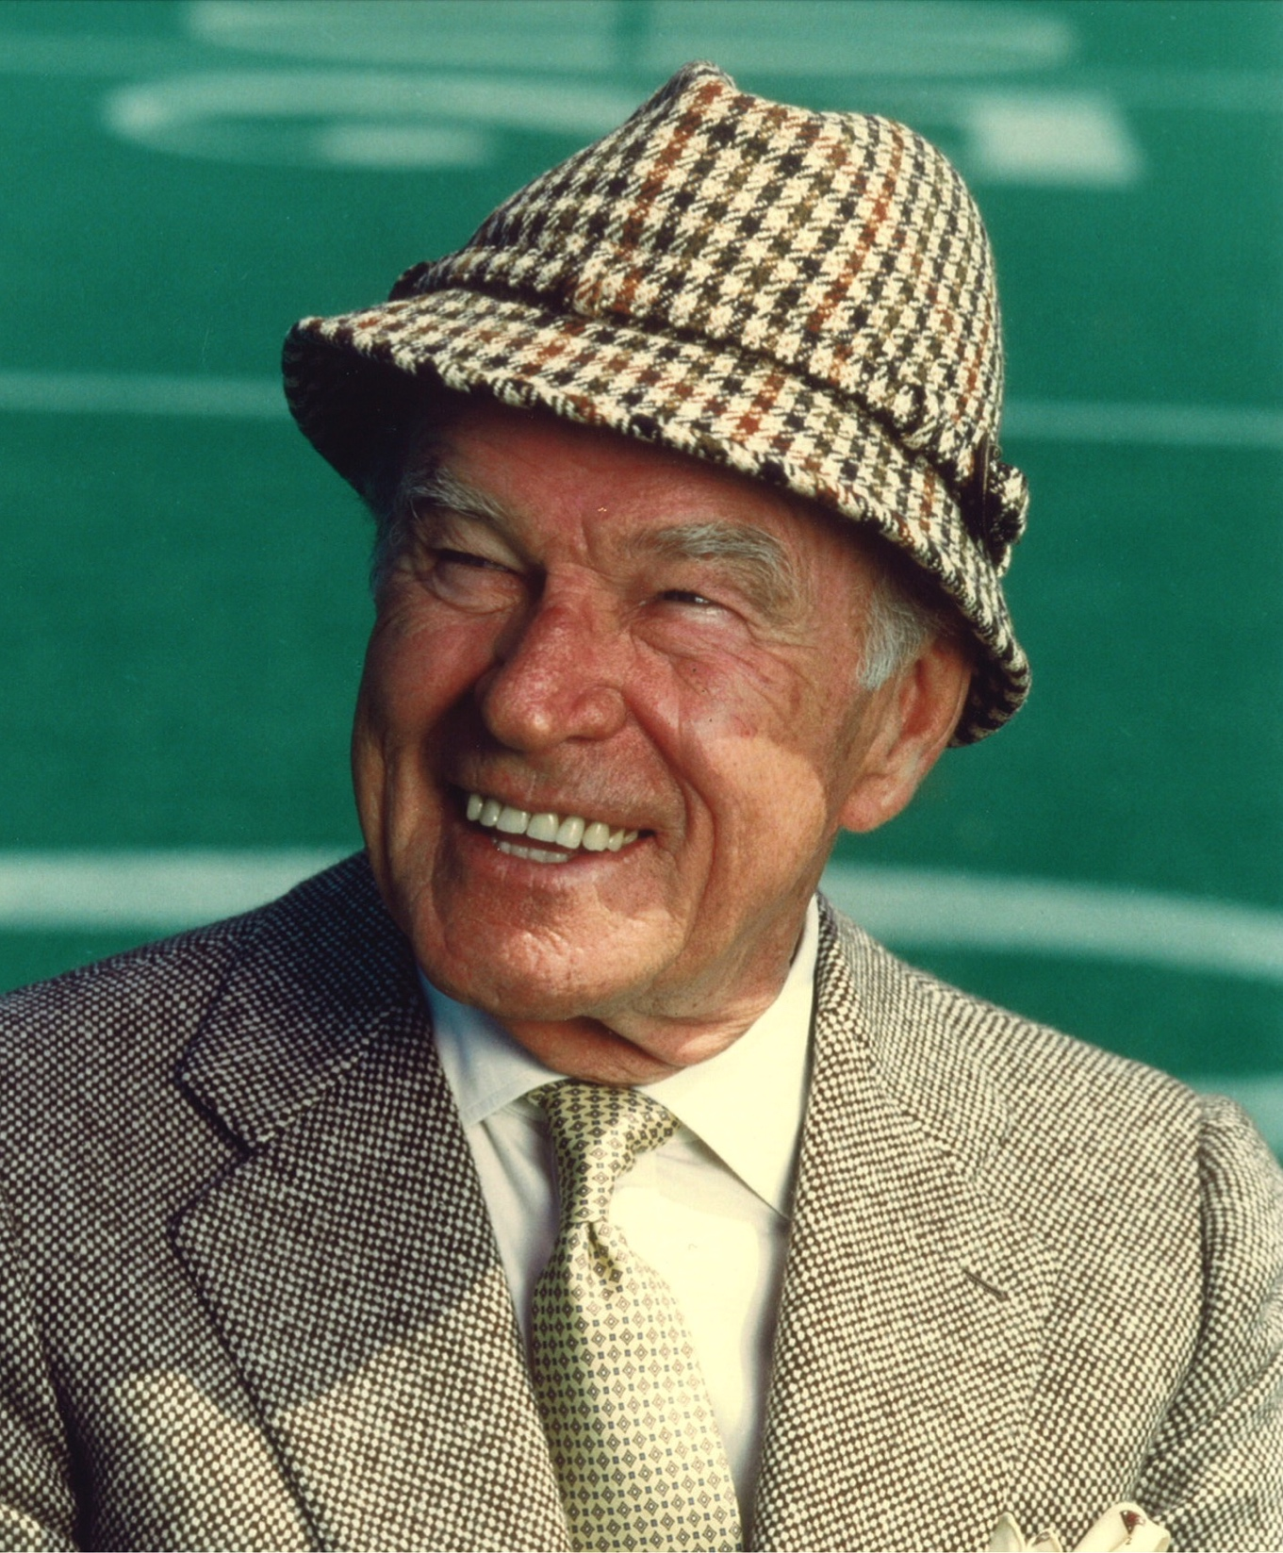
MR. COOKE’S LEGACY
Believed education was a life-long pursuit
An informal student of literature, music, sports, and architecture
Left the bulk of his fortune to establish the Cooke Foundation upon his death in 1997
Cooke Scholar community celebrates Mr. Cooke’s birthday on October 25
This is our 25th anniversary year!
Notes:
Mr. Cooke believed education was a life-long pursuit despite not being able to pursue a formal education himself.
He was a passionate student his entire life and was knowledgeable in fields as diverse as literature, music, sports, and architecture.
When he died in 1997, Mr. Cooke left the bulk of his fortune to establish the Cooke Foundation and provide remarkable students with the chance to soar.
Every year on October 25, the Cooke Scholar community celebrates Mr. Cooke’s birthday and the opportunities his generosity has made possible.

Slide 3
MISSION STATEMENT
The Jack Kent Cooke Foundation is dedicated to advancing the education of exceptionally talented students who have financial need.

Slide 4
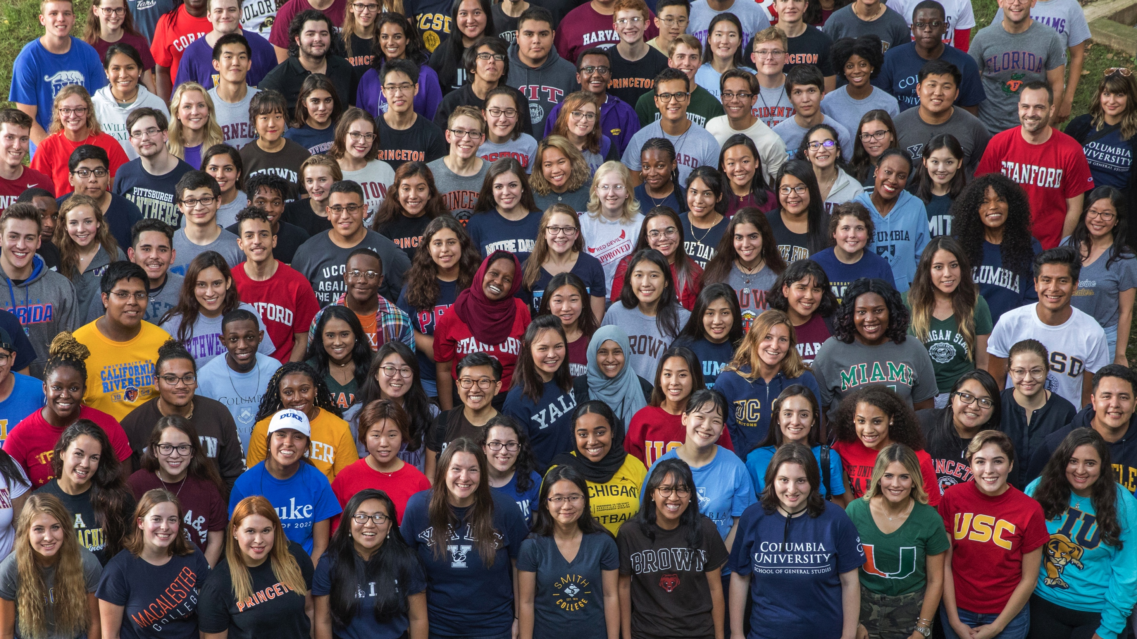
THREE UNIQUE SCHOLARSHIP PROGRAMS
YOUNG SCHOLARS PROGRAM: 8th – 12th Grade
COLLEGE SCHOLARSHIP PROGRAM: Four-year college scholarship
UNDERGRADUATE TRANSFER SCHOLARSHIP: Community college students aiming to transfer to a four-year college
3,800
$332 MILLION
$144 MILLION
SCHOLARS
AWARDED IN SCHOLARSHIPS
IN GRANTMAKING

Slide 5
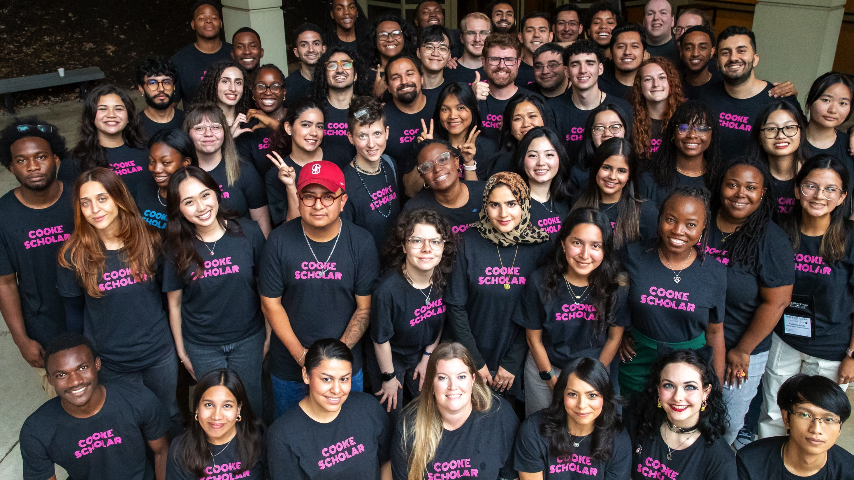
COOKE UNDERGRADUATE TRANSFER SCHOLARSHIP

Slide 6
TIMELINE: COOKE UNDERGRADUATE TRANSFER SCHOLARSHIP
OCTOBER
JANUARY
FEBRUARY
MAY
AUGUST
.com
Link to application made public via Common App
Application closes
Semifinalists announced
Scholarship recipients announced
Scholars Weekend in-person event

Slide 7
WHO CAN APPLY
ACADEMICS:
Cumulative, unweighted GPA of 3.5 or above on a 4.0 scale
FALL COLLEGE ENROLLMENT planned for a four-year U.S. college in fall 2026
SOPHOMORE STATUS at a two-year institution by January 1, 2026
FINANCIAL NEED: Maximum annual gross family income of $95,000
NO PREVIOUS FOUR-YEAR COLLEGE

Slide 8
TRANSFER SCHOLAR EXPERIENCE
CAREER &
GRADUATE SCHOOL PREP
ACADEMIC
ADVISING
PURSUE ANY AREA OF STUDY
INTERNSHIPS & PROFESSIONAL
CONFERENCES
COOKE SCHOLAR COMMUNITY
GENEROUS FINANCIAL
SUPPORT

Slide 9
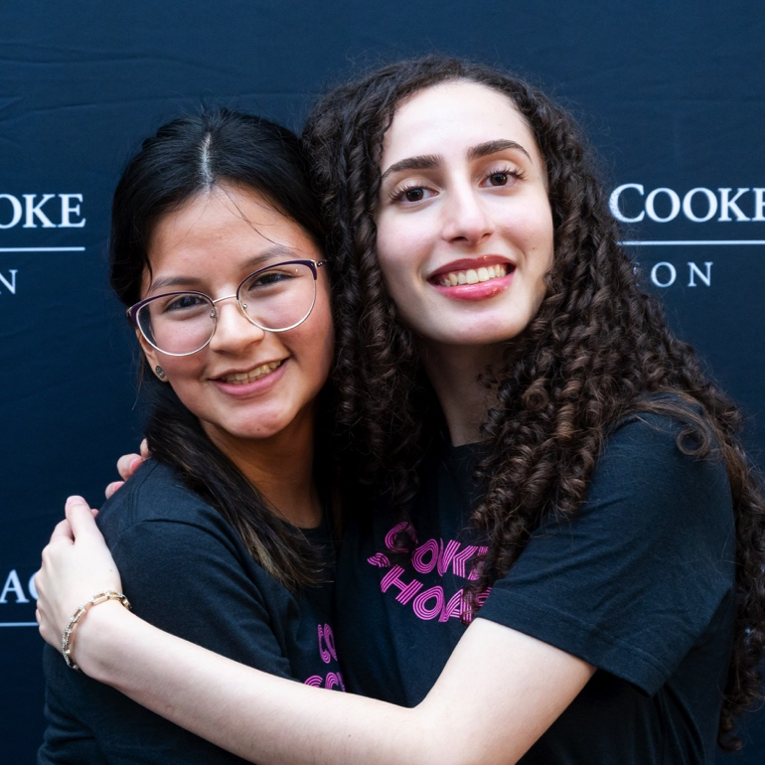

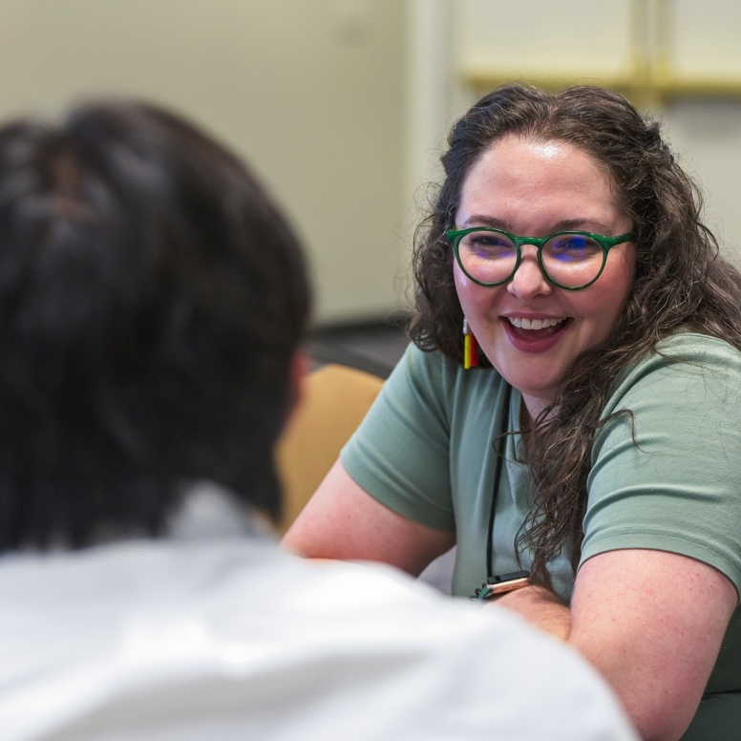
TRANSFER SCHOLAR COMMUNITY

Slide 10

QUESTIONS?
scholarships@jkcf.org

Slide 11
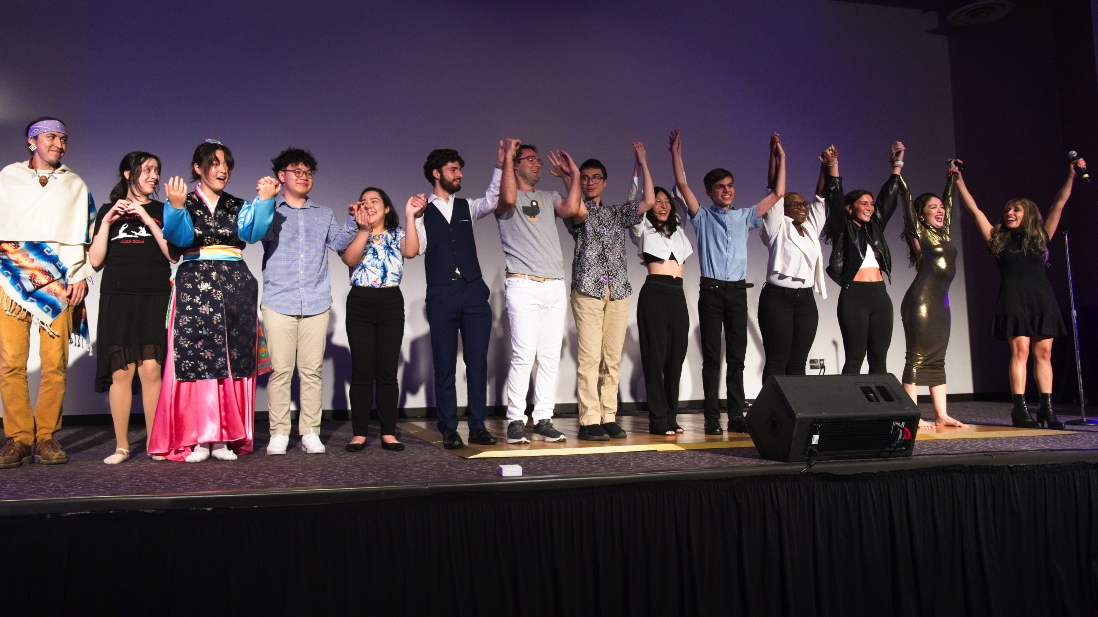
THANK YOU!

