Slide 1

Fall 2026
The Cooke Undergraduate Transfer Scholarship
Application period: August 19, 2026 – November 11, 2026

Slide 2
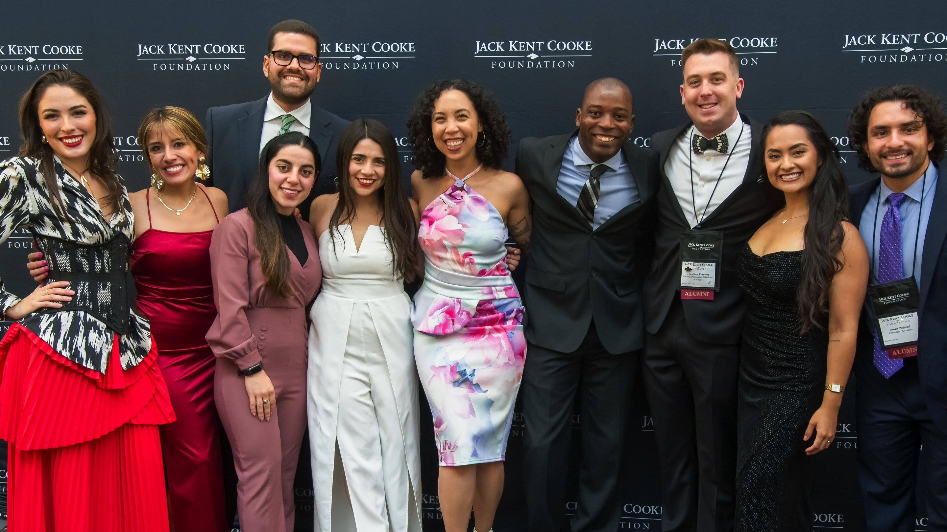
MEET THE FOUNDATION

Slide 3
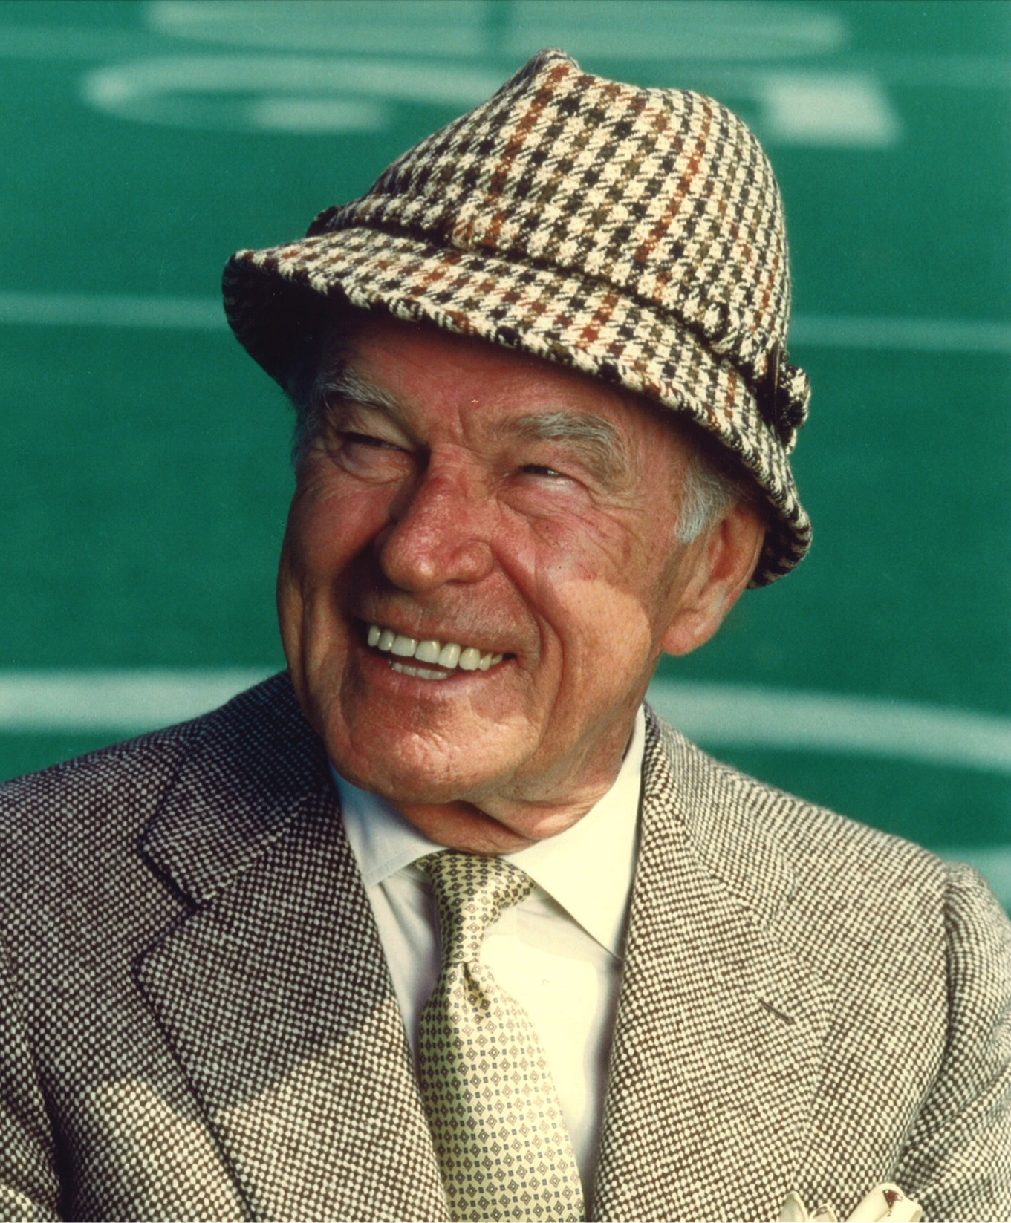
MR. COOKE’S LEGACY
Believed education was a life-long pursuit
An informal student of literature, music, sports, and architecture
Left the bulk of his fortune to establish the Cooke Foundation upon his death in 1997
Cooke Scholar community celebrates Mr. Cooke’s birthday on October 25
Notes:
Mr. Cooke believed education was a life-long pursuit despite not being able to pursue a formal education himself.
He was a passionate student his entire life and was knowledgeable in fields as diverse as literature, music, sports, and architecture.
When he died in 1997, Mr. Cooke left the bulk of his fortune to establish the Cooke Foundation and provide remarkable students with the chance to soar.
Every year on October 25, the Cooke Scholar community celebrates Mr. Cooke’s birthday and the opportunities his generosity has made possible.

Slide 4
MISSION STATEMENT
The Jack Kent Cooke Foundation is
dedicated to advancing the education
of exceptionally talented students
who have financial need.

Slide 5
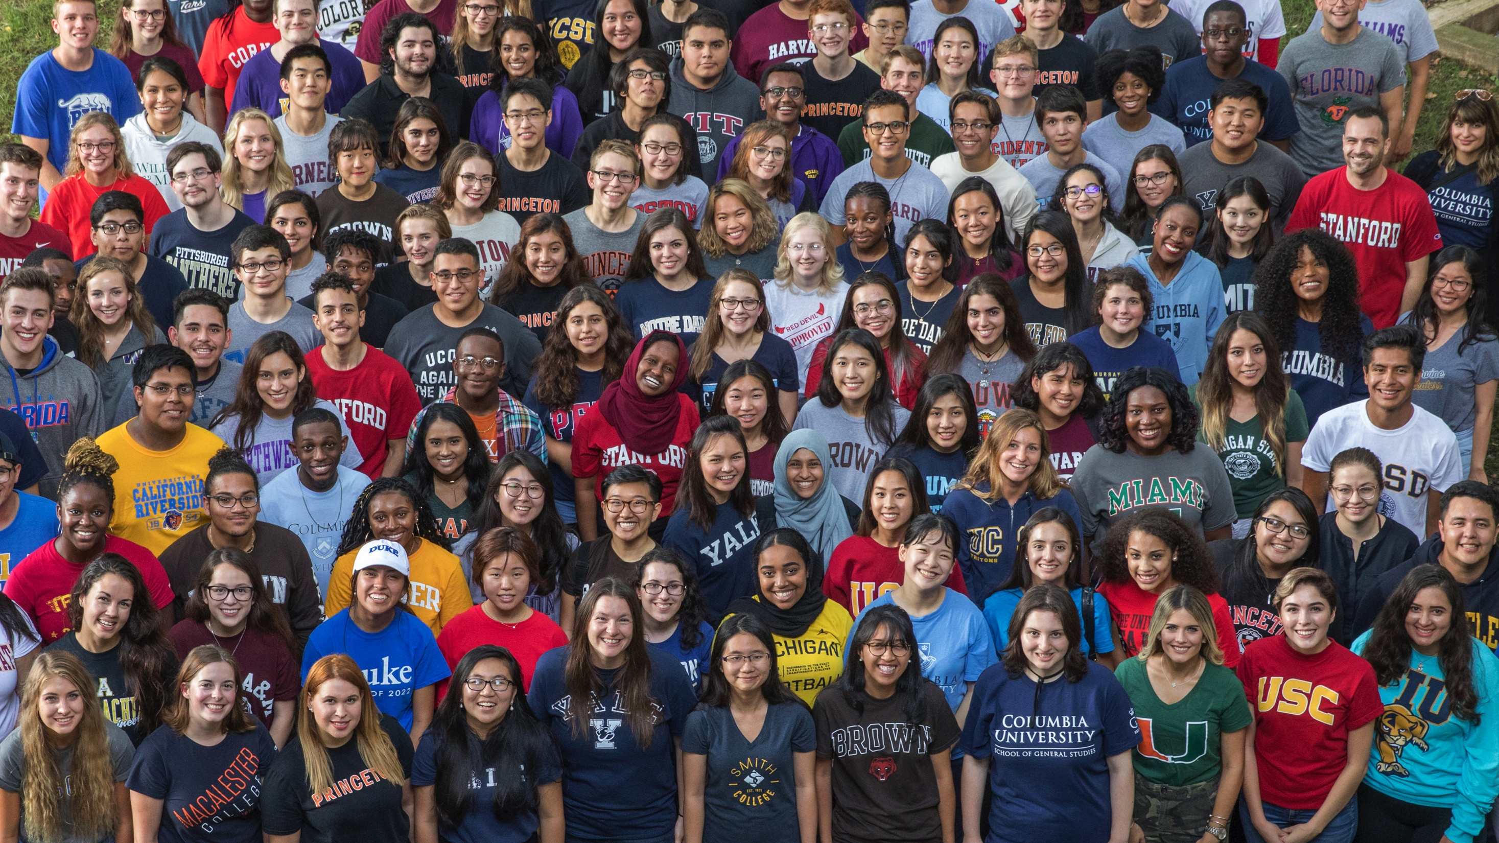
THREE UNIQUE SCHOLARSHIP PROGRAMS
YOUNG SCHOLARS PROGRAM:
8th – 12th Grade
COLLEGE SCHOLARSHIP PROGRAM:
Four-year college scholarship
UNDERGRADUATE TRANSFER SCHOLARSHIP:
Community college students aiming to transfer to a
four-year college
3,600
$332 MILLION
$144 MILLION
SCHOLARS
AWARDED IN SCHOLARSHIPS
IN GRANTMAKING

Slide 6
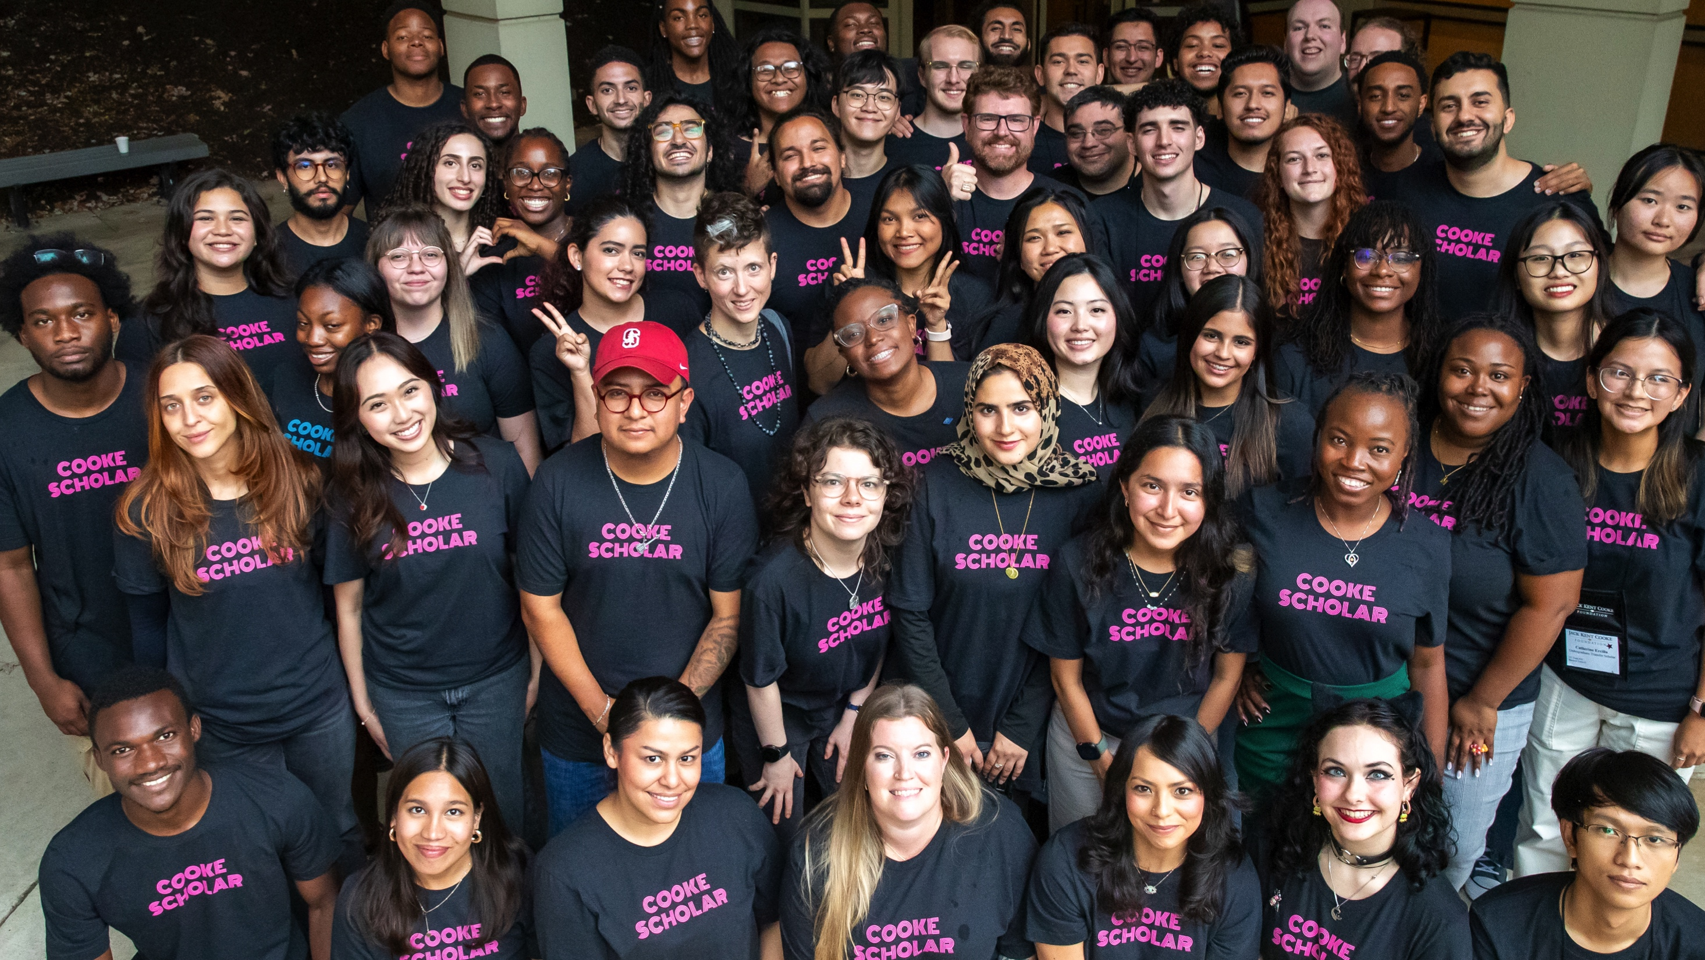
COOKE UNDERGRADUATE TRANSFER SCHOLARSHIP

Slide 7
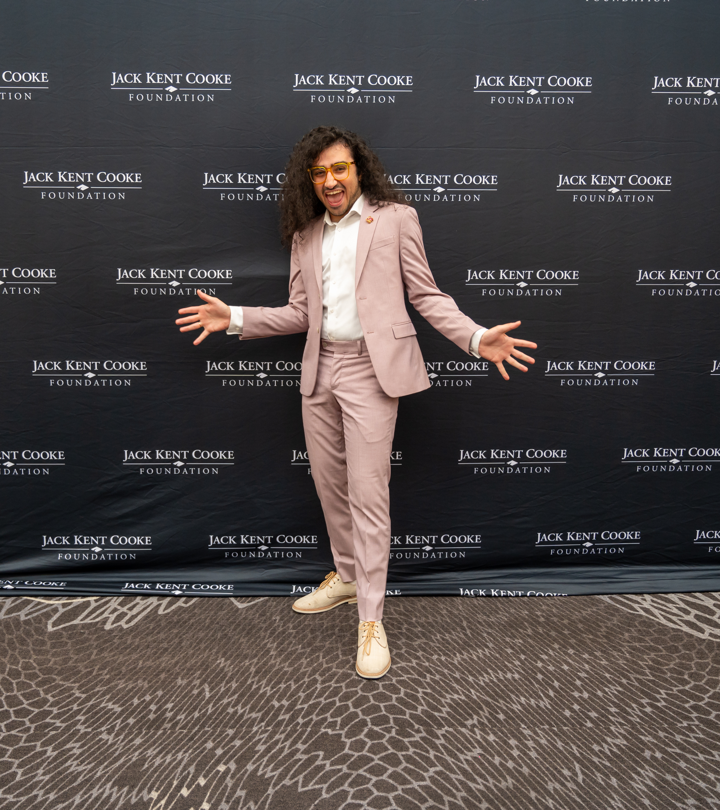
SCHOLARSHIP AMOUNT
Last dollar funding after all institutional aid
Can provide as much as $55,000 per year for two to three years
Complete a bachelor’s degree at any accredited four-year undergraduate institution in the U.S.
Notes:
The award, which is last dollar funding after all institutional aid, can provide as much as $55,000 per year for two to three years to complete a bachelor’s degree at any accredited four-year undergraduate institution in the U.S.

Slide 8



TIMELINE: COOKE UNDERGRADUATE
TRANSFER SCHOLARSHIP
AUGUST
DECEMBER
MARCH
APRIL
AUGUST
.com
Link to application made public via Common App
Application closes
Semifinalists
announced
Scholarship
recipients
announced
Scholars Weekend in-person event

Slide 9



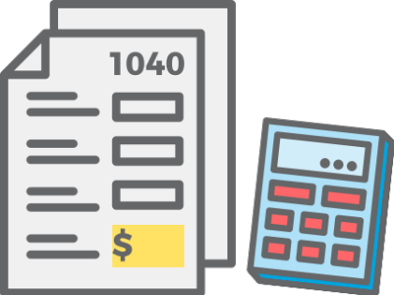
WHO CAN APPLY
ACADEMICS:
Cumulative, unweighted GPA of 3.5 or above on a 4.0 scale
FALL COLLEGE ENROLLMENT planned for a four-year U.S. college in fall 2027
SOPHOMORE STATUS at a two-year institution by January 1, 2027
FINANCIAL NEED: Maximum annual gross family income of $95,000
NO PREVIOUS FOUR-YEAR COLLEGE

Slide 10






TRANSFER SCHOLAR EXPERIENCE
CAREER &
GRADUATE SCHOOL PREP
ACADEMIC
ADVISING
PURSUE ANY
AREA OF STUDY
INTERNSHIP
& PROFESSIONAL
CONFERENCES
COOKE SCHOLAR
COMMUNITY
GENEROUS FINANCIAL
SUPPORT

Slide 11
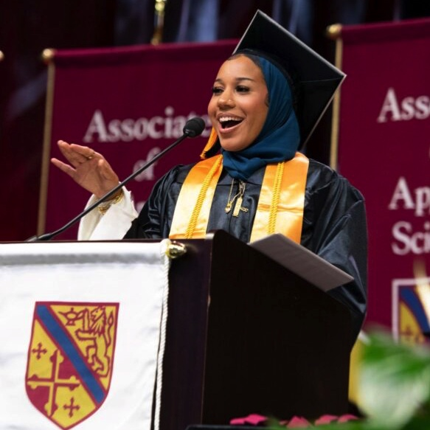
TRANSFER SCHOLAR SPOTLIGHT: ISRAAH
2023 Cooke Transfer Scholar; senior psychology and political science major at Johns Hopkins University
Passionate about social justice and education policy and an active member of her community/campus
Keynote speaker at the 2024 Martin Luther King, Jr. holiday celebration at Howard Community College
At HCC, was president of student government
Recently joined Sova’s Beyond Transfer Policy Advisory Board.
Notes:
A 2023 Cooke Transfer Scholar, Israah is a senior psychology and political science major at Johns Hopkins University. Passionate about social justice and education policy, she is an active member of her community and is committed to enacting change on her campus. Israah was recently the keynote speaker at the 2024 Martin Luther King, Jr. holiday celebration hosted at her alma mater, Howard Community College. During her time at HCC, she was president of student government where she started their first ever homecoming celebration, and made sure students had safe spaces on campus to talk about issues in diversity, equity, and inclusion. She has also recently joined Sova’s Beyond Transfer Policy Advisory Board.

Slide 12
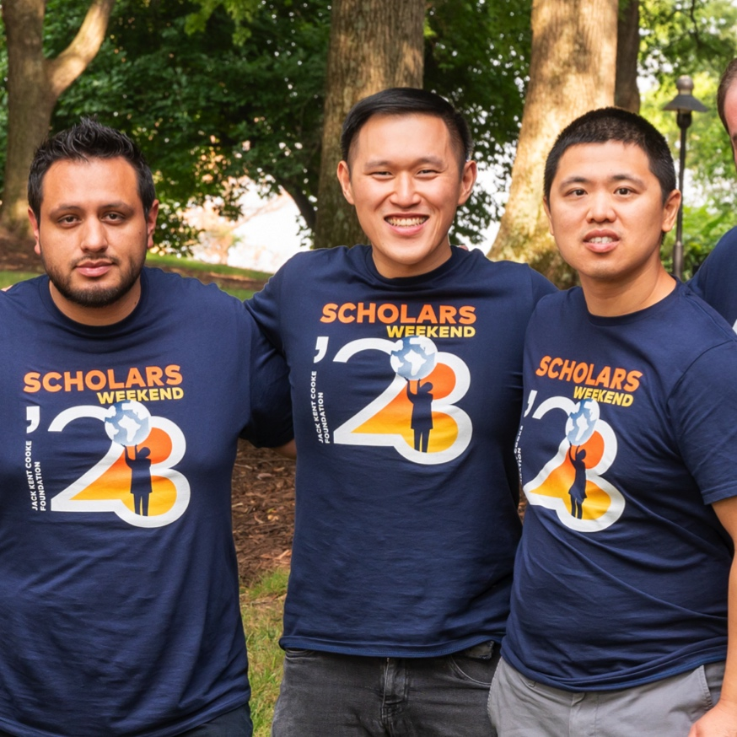
TRANSFER SCHOLAR SPOTLIGHT: RYAN
2015 Cooke Transfer Scholar; Yale and Oxford graduate
Currently an attorney in Los Angeles
Recently elected as a Governing Board Member for his community college alma mater, Pasadena City College
Advocate for other community college and transfer students
One of the first transfer students to ever attend Yale
Notes:
2015 Cooke Undergraduate Transfer Scholar Ryan, a Yale and Oxford graduate, currently serves as an attorney at Cooley LLP in Los Angeles. Ryan was also recently elected as a Governing Board Member for his community college alma mater, Pasadena City College, and works as an advocate on behalf of other community college and transfer students. As one of the first transfer students to ever attend Yale, he has since paved the way for other community college students to transfer to the country’s most selective colleges.

Slide 13
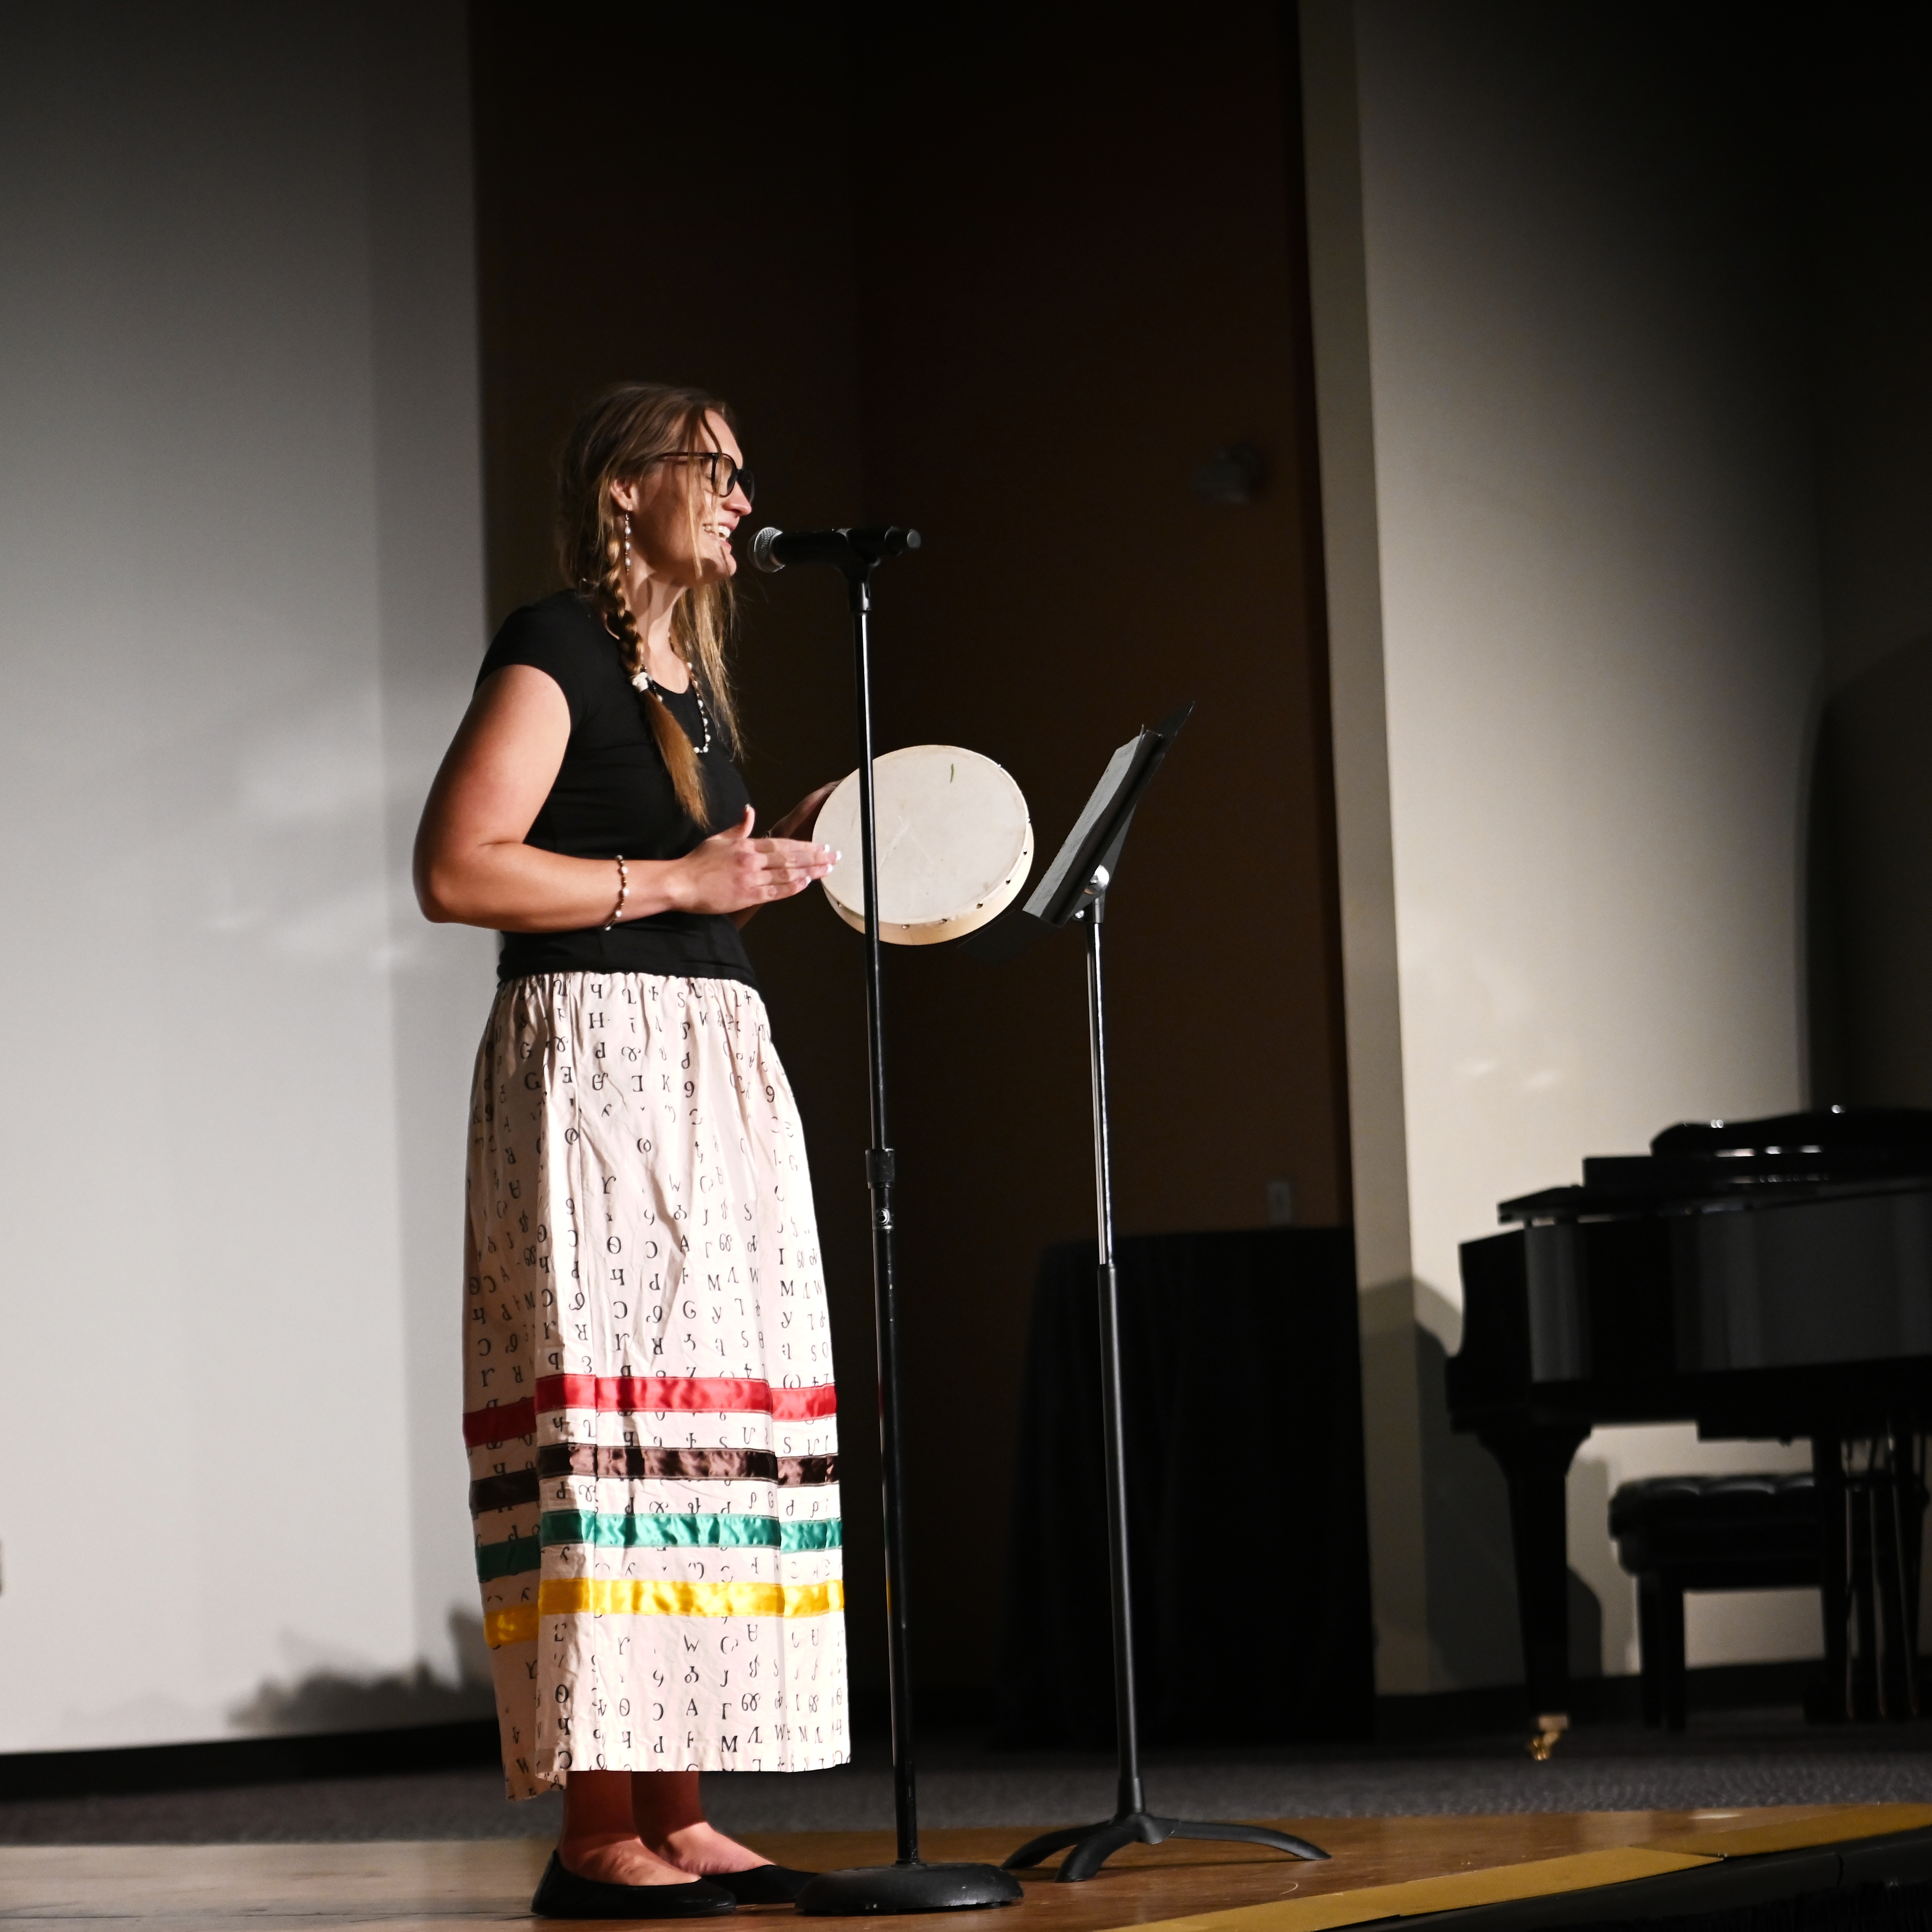
TRANSFER SCHOLAR SPOTLIGHT: KELLY
2023 Cooke Transfer Scholar; attends University of Tulsa
Grew up in Cherokee Nation
Dreams of becoming a doctor; biology student
A non-traditional student, lives with children on campus; family does homework together every night

Slide 14
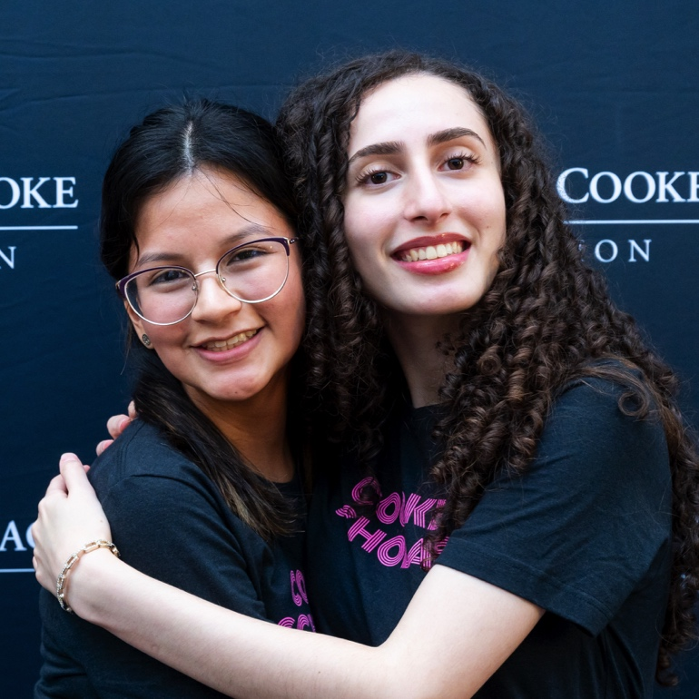
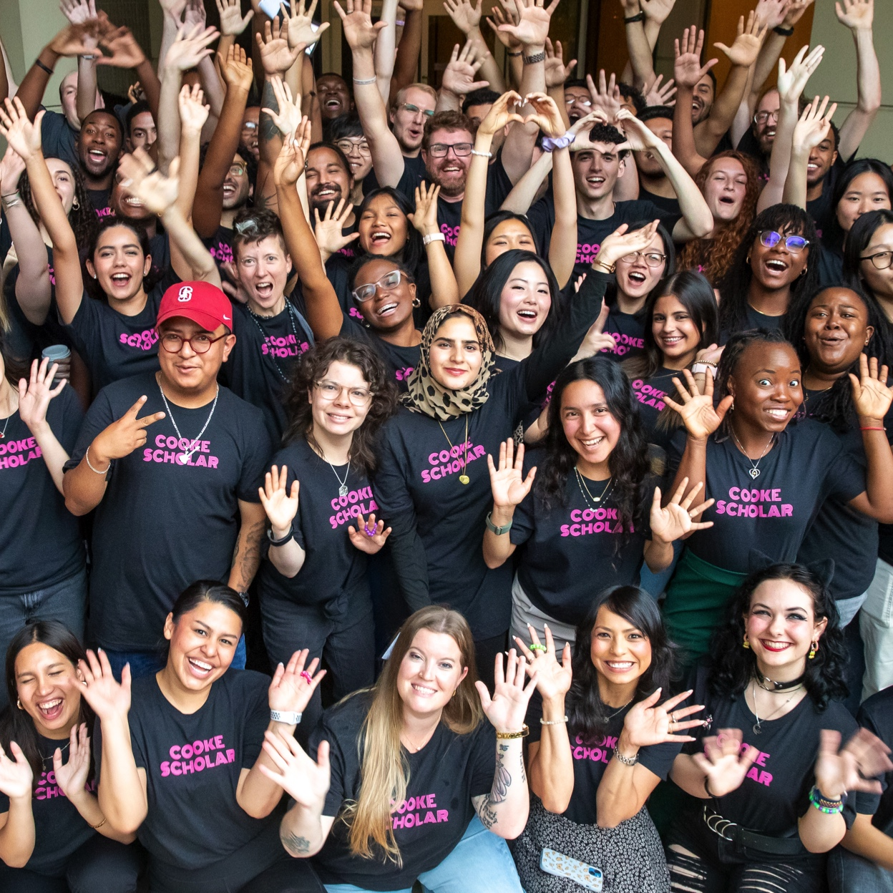
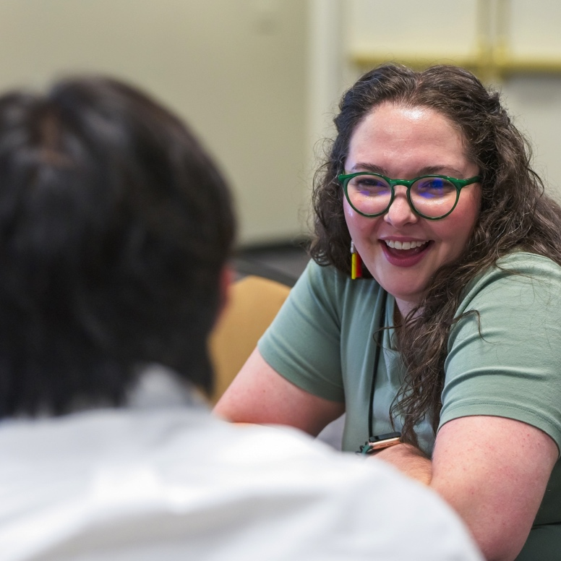
TRANSFER SCHOLAR COMMUNITY

Slide 15
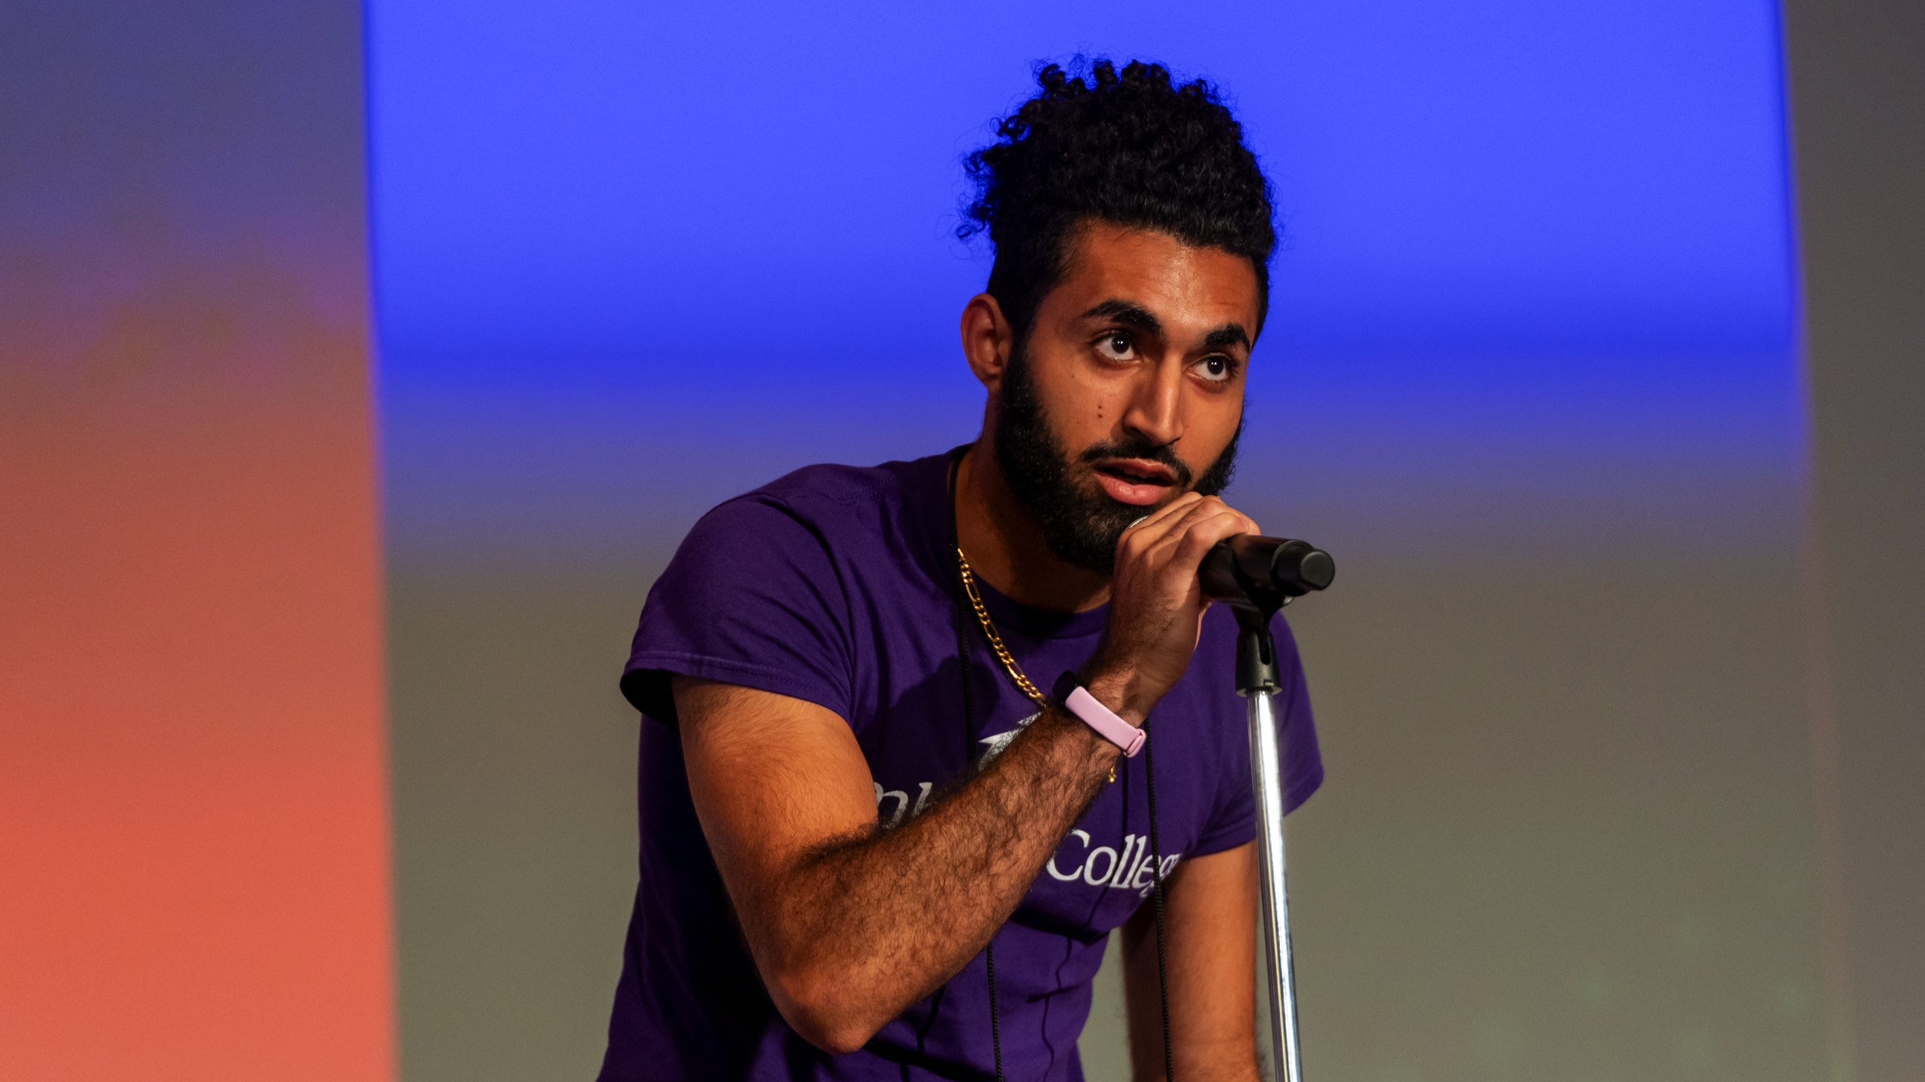
QUESTIONS?

Slide 16
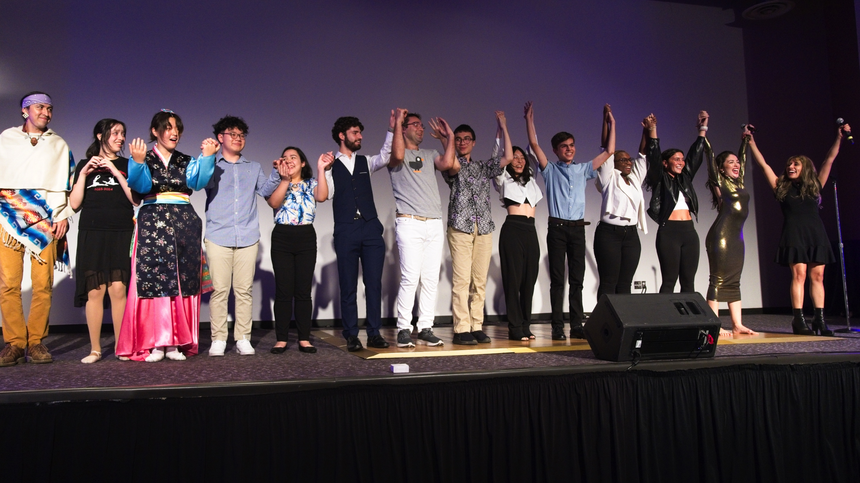
THANK YOU!

