Slide 1
The Cooke College Scholarship
Application Period: August 19 – November 11, 2026

Slide 2
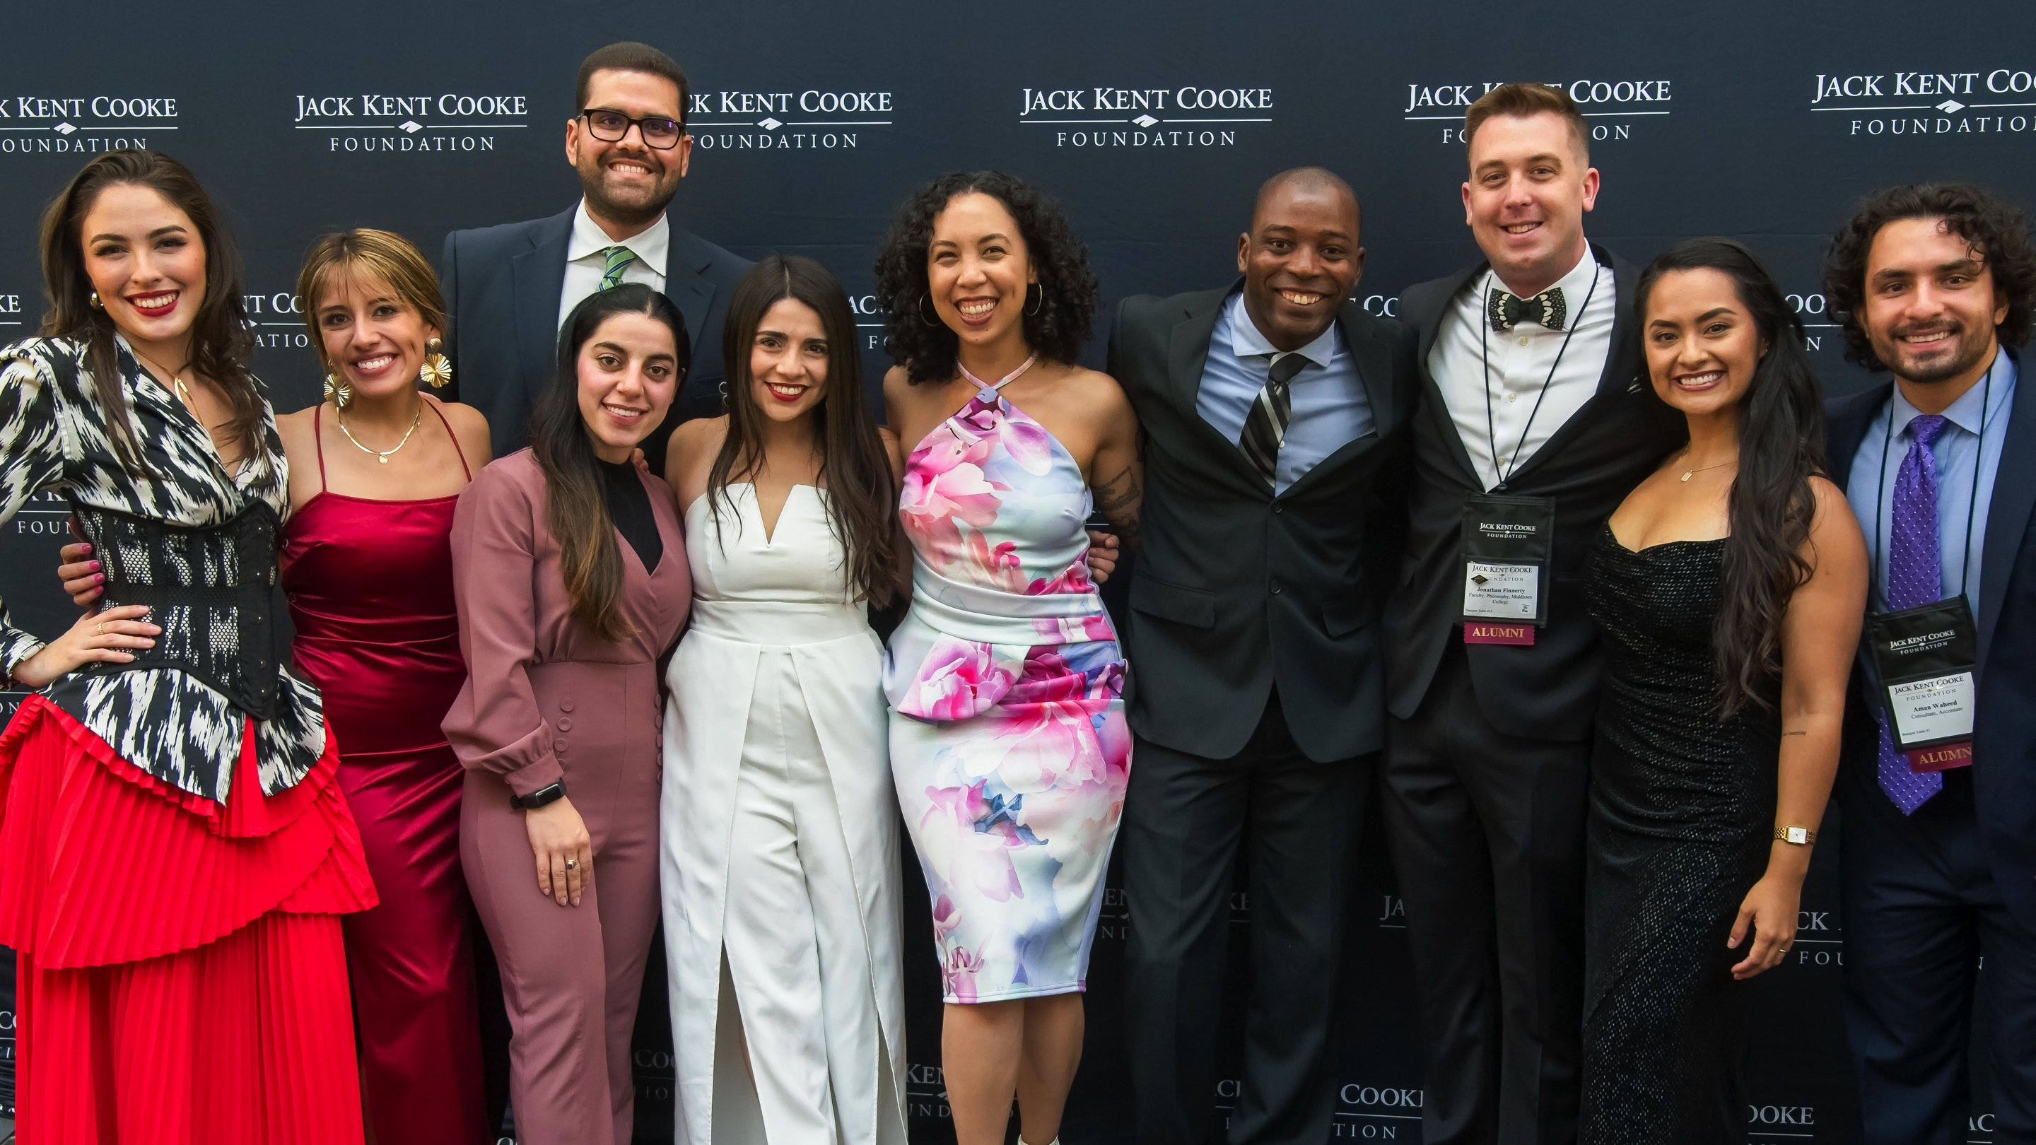
MEET THE FOUNDATION

Slide 3
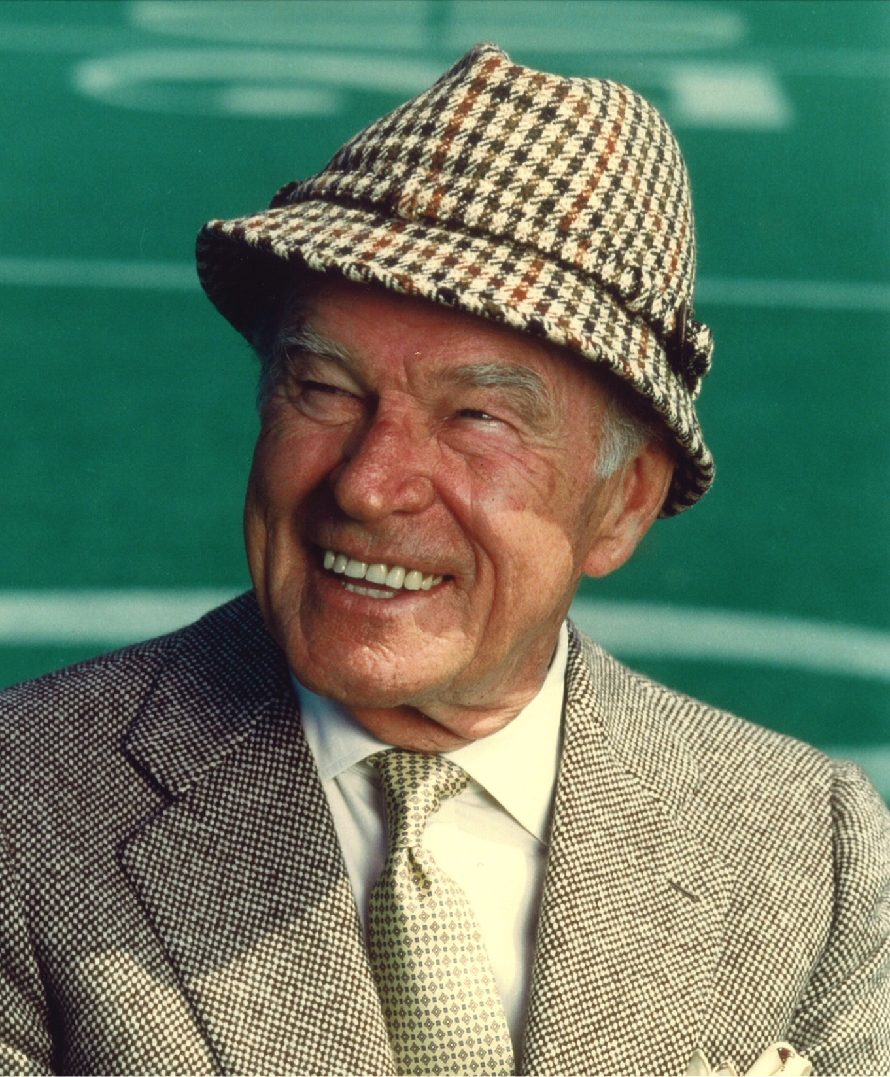
MR. COOKE’S LEGACY
Believed education was a life-long pursuit
Knowledgeable in fields as diverse as literature, music, sports, and architecture.
When he died in 1997, Mr. Cooke left the bulk of his fortune to establish the Cooke Foundation and provide remarkable students with the chance to soar.
Every year on October 25, the Cooke Scholar community celebrates Mr. Cooke’s birthday and the opportunities his generosity has made possible.

Slide 4
MISSION STATEMENT
The Jack Kent Cooke Foundation is
dedicated to advancing the education
of exceptionally talented students
who have financial need.

Slide 5
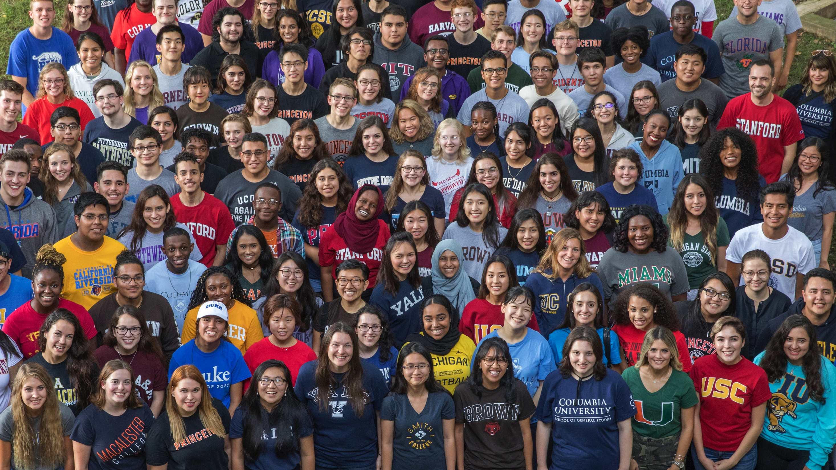
THREE UNIQUE SCHOLARSHIP PROGRAMS
YOUNG SCHOLARS PROGRAM:
8th – 12th Grade
COLLEGE SCHOLARSHIP PROGRAM:
Four-year college scholarship
UNDERGRADUATE TRANSFER SCHOLARSHIP:
Community college students aiming to transfer to a
four-year college
3,900
$332 MILLION
$144 MILLION
SCHOLARS
AWARDED IN SCHOLARSHIPS
IN GRANTMAKING

Slide 6
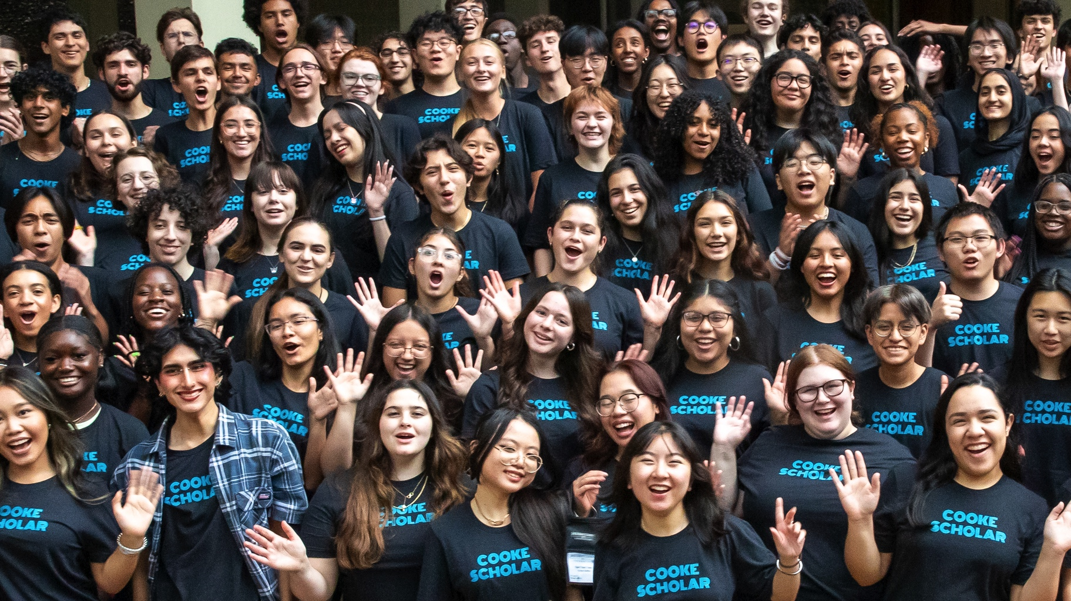
COOKE COLLEGE SCHOLARSHIP PROGRAM

Slide 7
TIMELINE: COOKE COLLEGE SCHOLARSHIP PROGRAM
AUGUST
NOVEMBER
JANUARY
MARCH
AUGUST
.com
Link to application made public via Common App
Application closes
Semifinalists
announced
Scholarship
recipients
announced
Scholars Weekend in-person event

Slide 8
WHO CAN APPLY
ACADEMICS:
Cumulative, unweighted GPA of 3.75 or above
FALL COLLEGE ENROLMENT:
Enrolling in an accredited four-year U.S. college in fall 2027
SENIOR STANDING: Graduating from a U.S. high school in spring 2027
FINANCIAL NEED: Median family income for last year’s cohort was $34,000

Slide 9
COLLEGE SCHOLAR EXPERIENCE
PURSUE ANY
AREA OF STUDY
EDUCATIONAL
ADVISER
CAREER &
GRADUATE SCHOOL EXPLORATION
INTERNSHIP
& TRAVEL OPPORTUNITIES
COOKE SCHOLAR
COMMUNITY
GRADUATE
DEBT-FREE

Slide 10

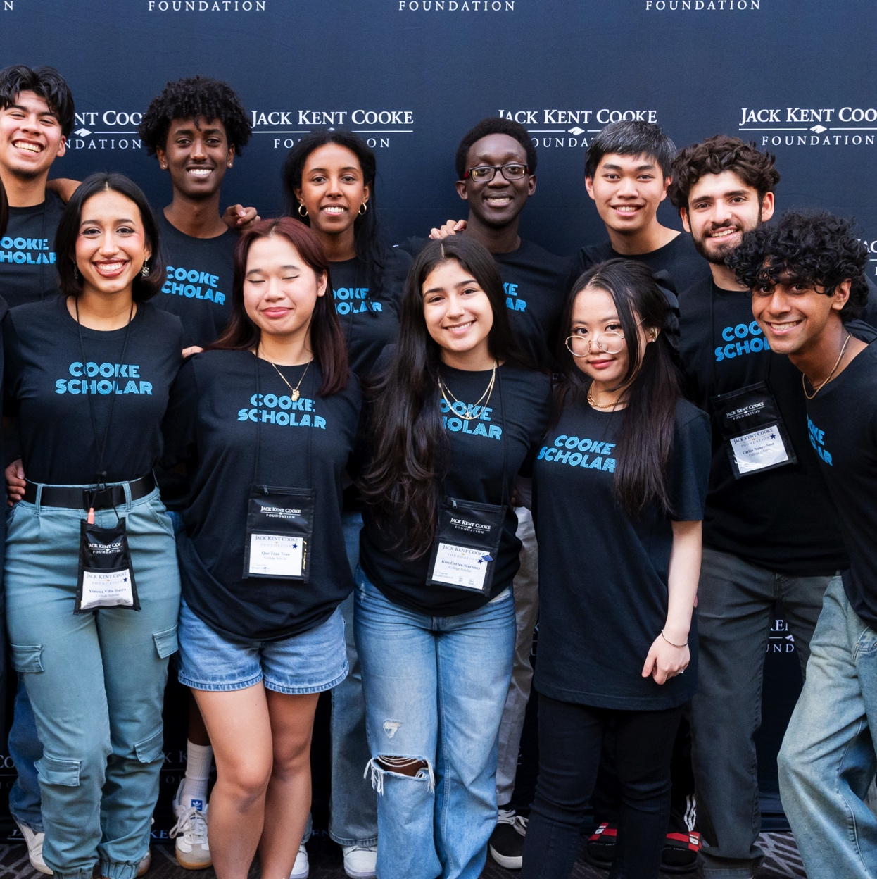
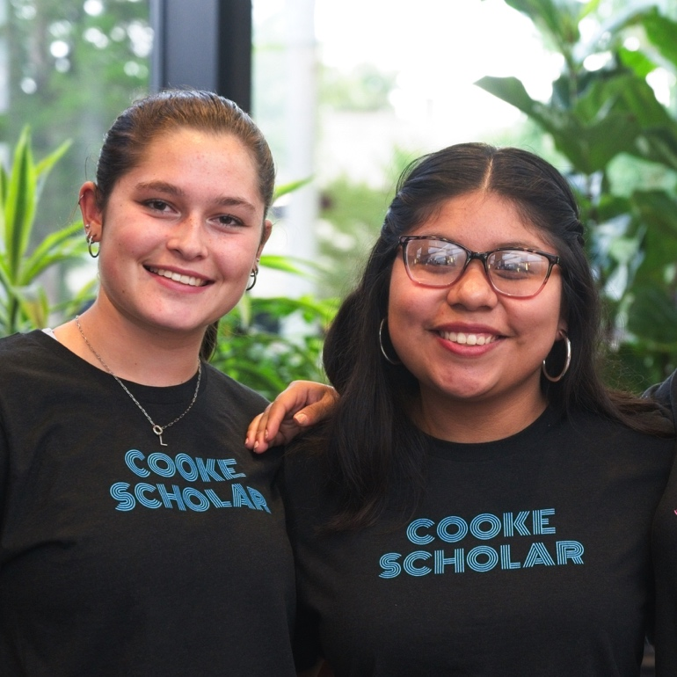
COLLEGE SCHOLAR COMMUNITY

Slide 11
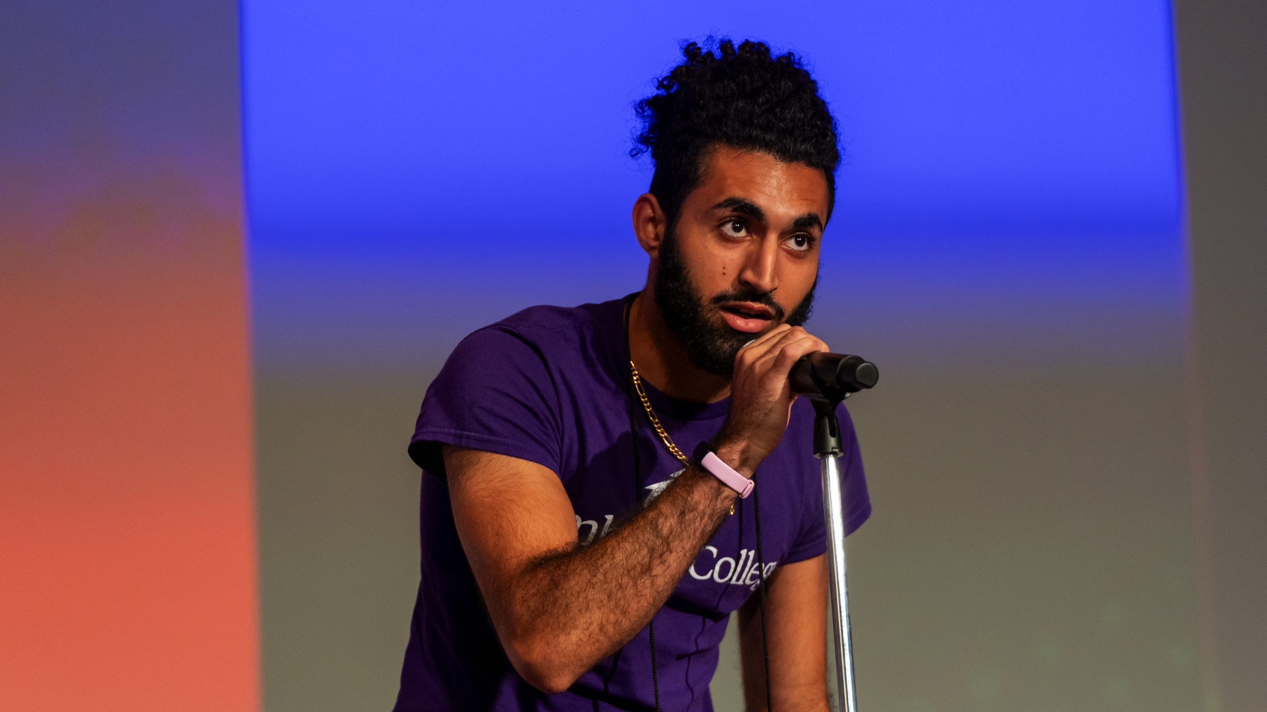
QUESTIONS?

Slide 12
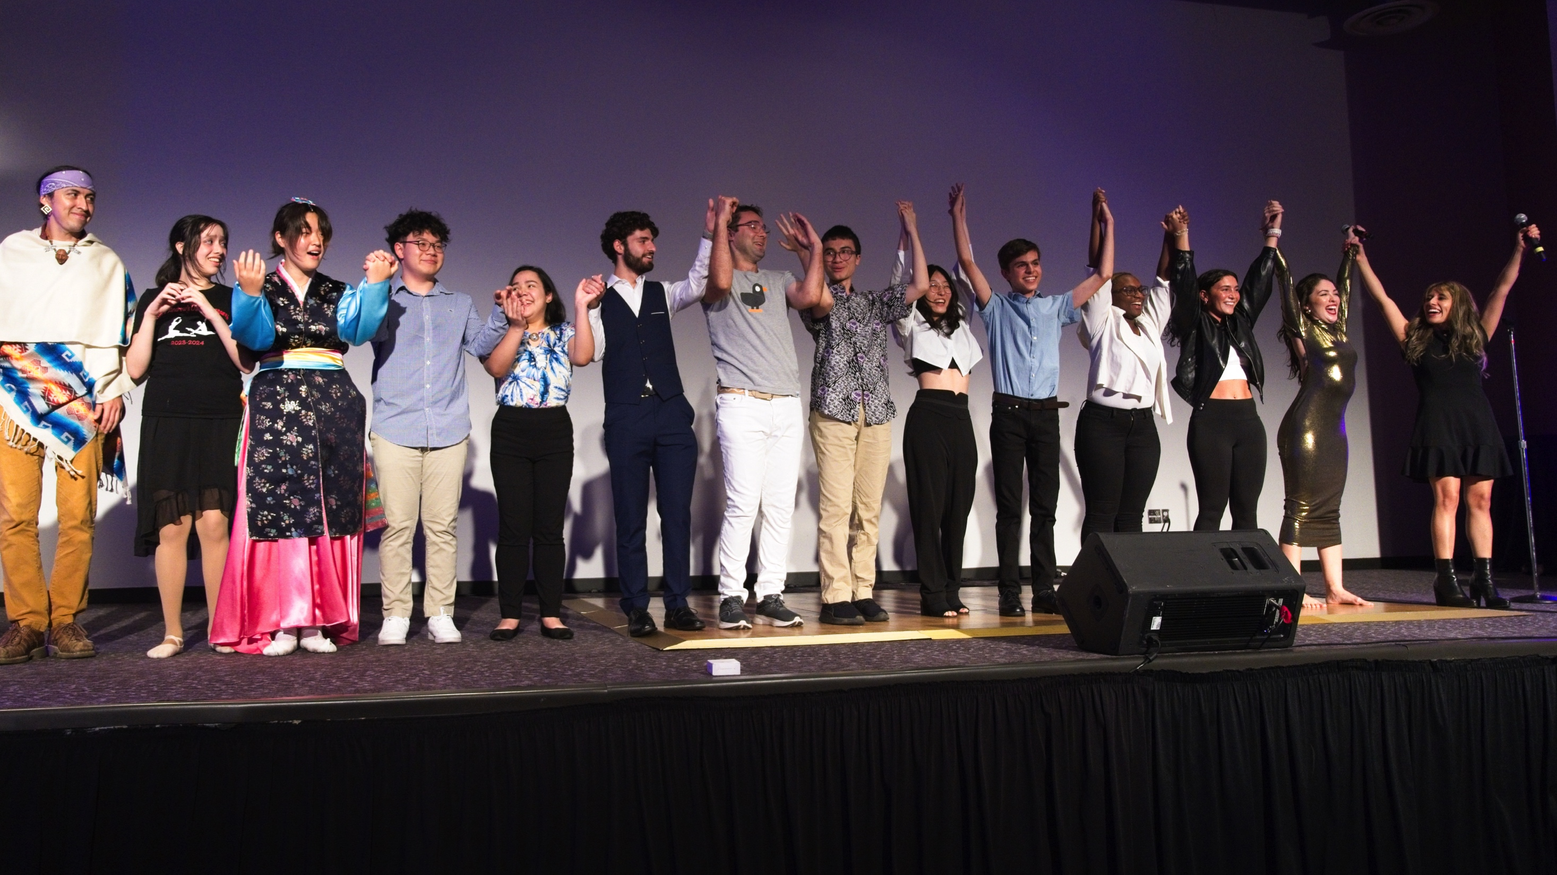
THANK YOU!

