Slide 1

Fall 2026
Cooke Campus Representative Portal
Training Document

Slide 2
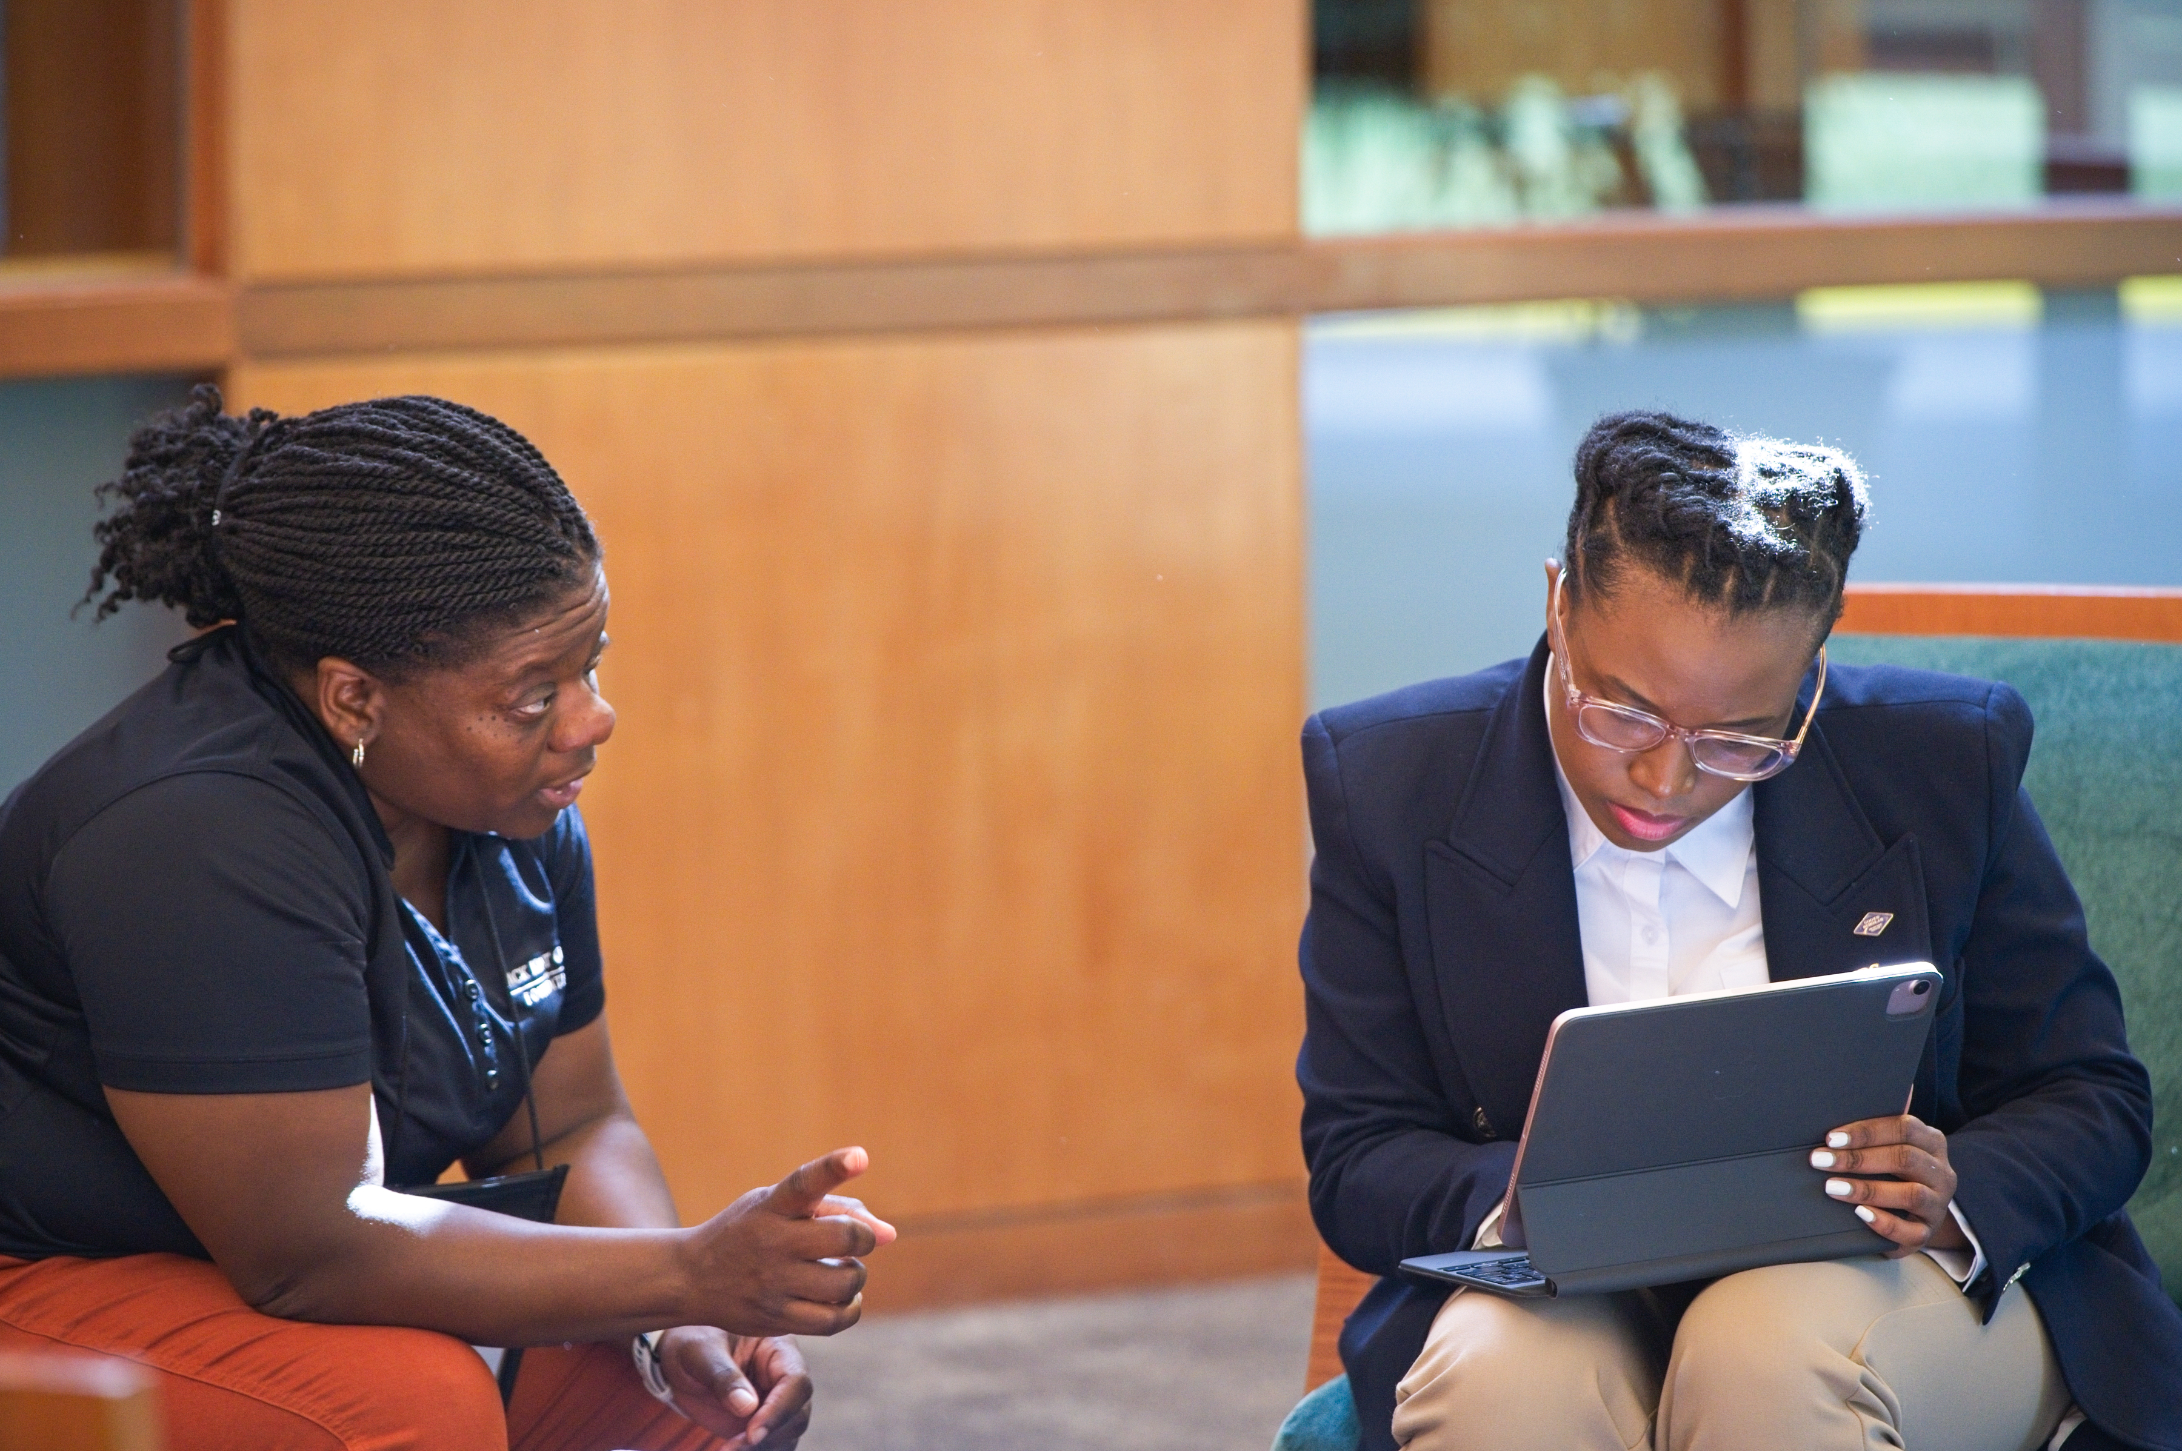
Cooke Campus Representative Role
Campus Representatives are faculty or staff members who support eligible students throughout the Undergraduate Transfer Scholarship application process.
Cooke Foundation Staff partner with Campus Reps to support outreach efforts and help students successfully complete their application.
Campus Reps receive scholarship decisions before applicants so they can help coordinate communication and student support.
Some campuses organize surprise celebrations or recognition events to honor scholarship recipients.

Slide 3
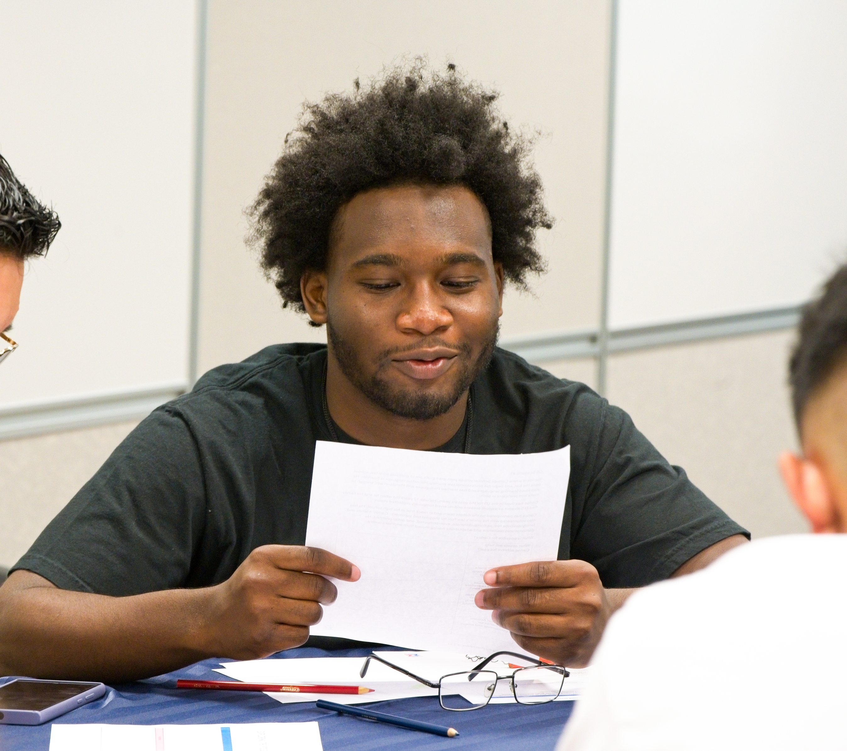
Before We Begin
All Campus Reps must complete the User Agreement Form prior to accessing the portal:
https://apply.jkcf.org/register/externaluseragreement
To protect student information, the portal is only available to those who are registered with the Foundation as a Campus Representative. Please click here to update your information.

Slide 4
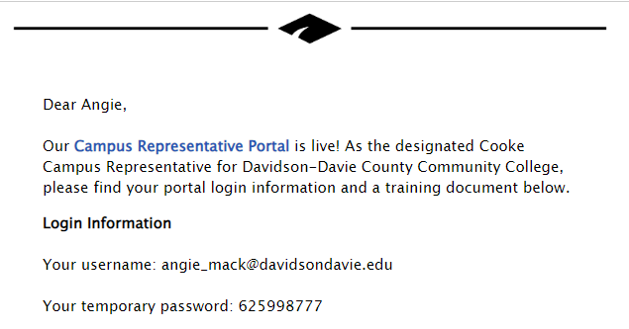
Portal Login
After submitting the User Agreement Form, you will receive an email with a link to the portal:
Username: your email address
Password: temporarily assigned to you, then you will create your personal password
Please email scholarships@jkcf.org with any password issues

Slide 5
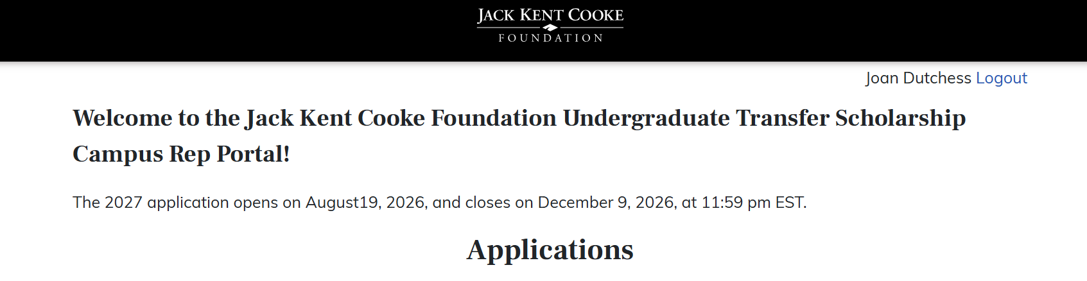
Portal Home Page
The Portal Home Page looks like this:

Slide 6
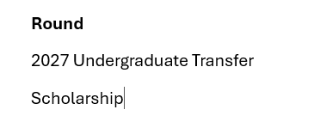
Application Round
All applicant rows should display the 2027 Undergraduate Transfer Scholarship, indicating they are applying for the application that is currently open.
The application opened on August 19, 2026, and will close on December 9, 2026.

Slide 7

Student Contact Information
This portal provides the names and email addresses of applicants on your campus.
You may copy email addresses from the portal and paste in Excel sheets to send bulk emails to your students. You may also connect individually.
Please be aware students may have used a personal email address rather than a school-provided email address to create their Common App for Transfer account.

Slide 8
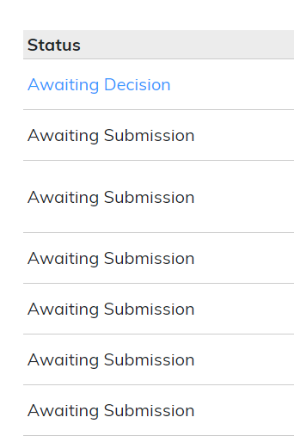
Application Status
There are three possible application statuses you might see for your students’ applications:
Awaiting Decision: student has submitted Common App for Transfer, two recommendation letters, resume, and transcript. This is a complete application.
Awaiting Materials: student has submitted Common App for Transfer but is missing supplemental materials (rec letters, resume, and/or transcript).
Awaiting Submission: student has not submitted Common App for Transfer.

Slide 9
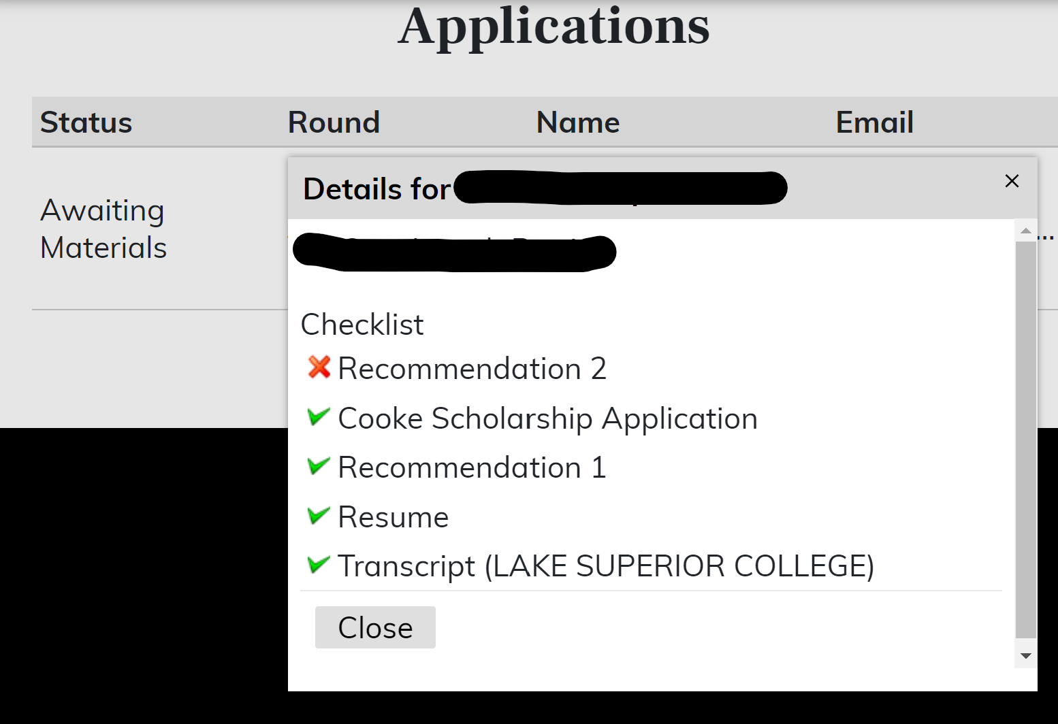
Checklist Pop-ups
You can click on each application in the home page to view a checklist specific to that student’s application.

Slide 10
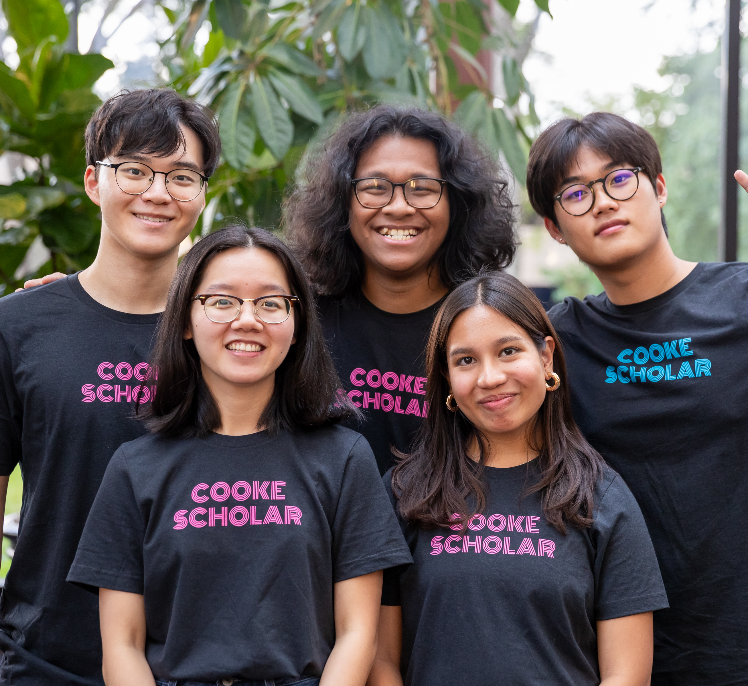
Troubleshooting
If you know a student who intends to apply but their name is not listed in your portal, check with them about the following:
Have they added the Jack Kent Cooke Foundation program to their Common App for Transfer?
Have they included a different campus in their coursework information? It is possible they are listed under that college’s portal and not yours.
Contact Zach at zcampion@jkcf.org if needed.

Slide 11
Other Resources and Support
For Questions about the Scholarship and Eligibility:
www.jkcf.org/transfer
scholarships@jkcf.org
For Questions about the Common App for Transfer:
https://help.liaisonedu.com/The_Common_App_Help_Center
thecommonapplication@liaisoncas.com
Response time: 1-2 business days, 3 days during busiest times

Slide 12
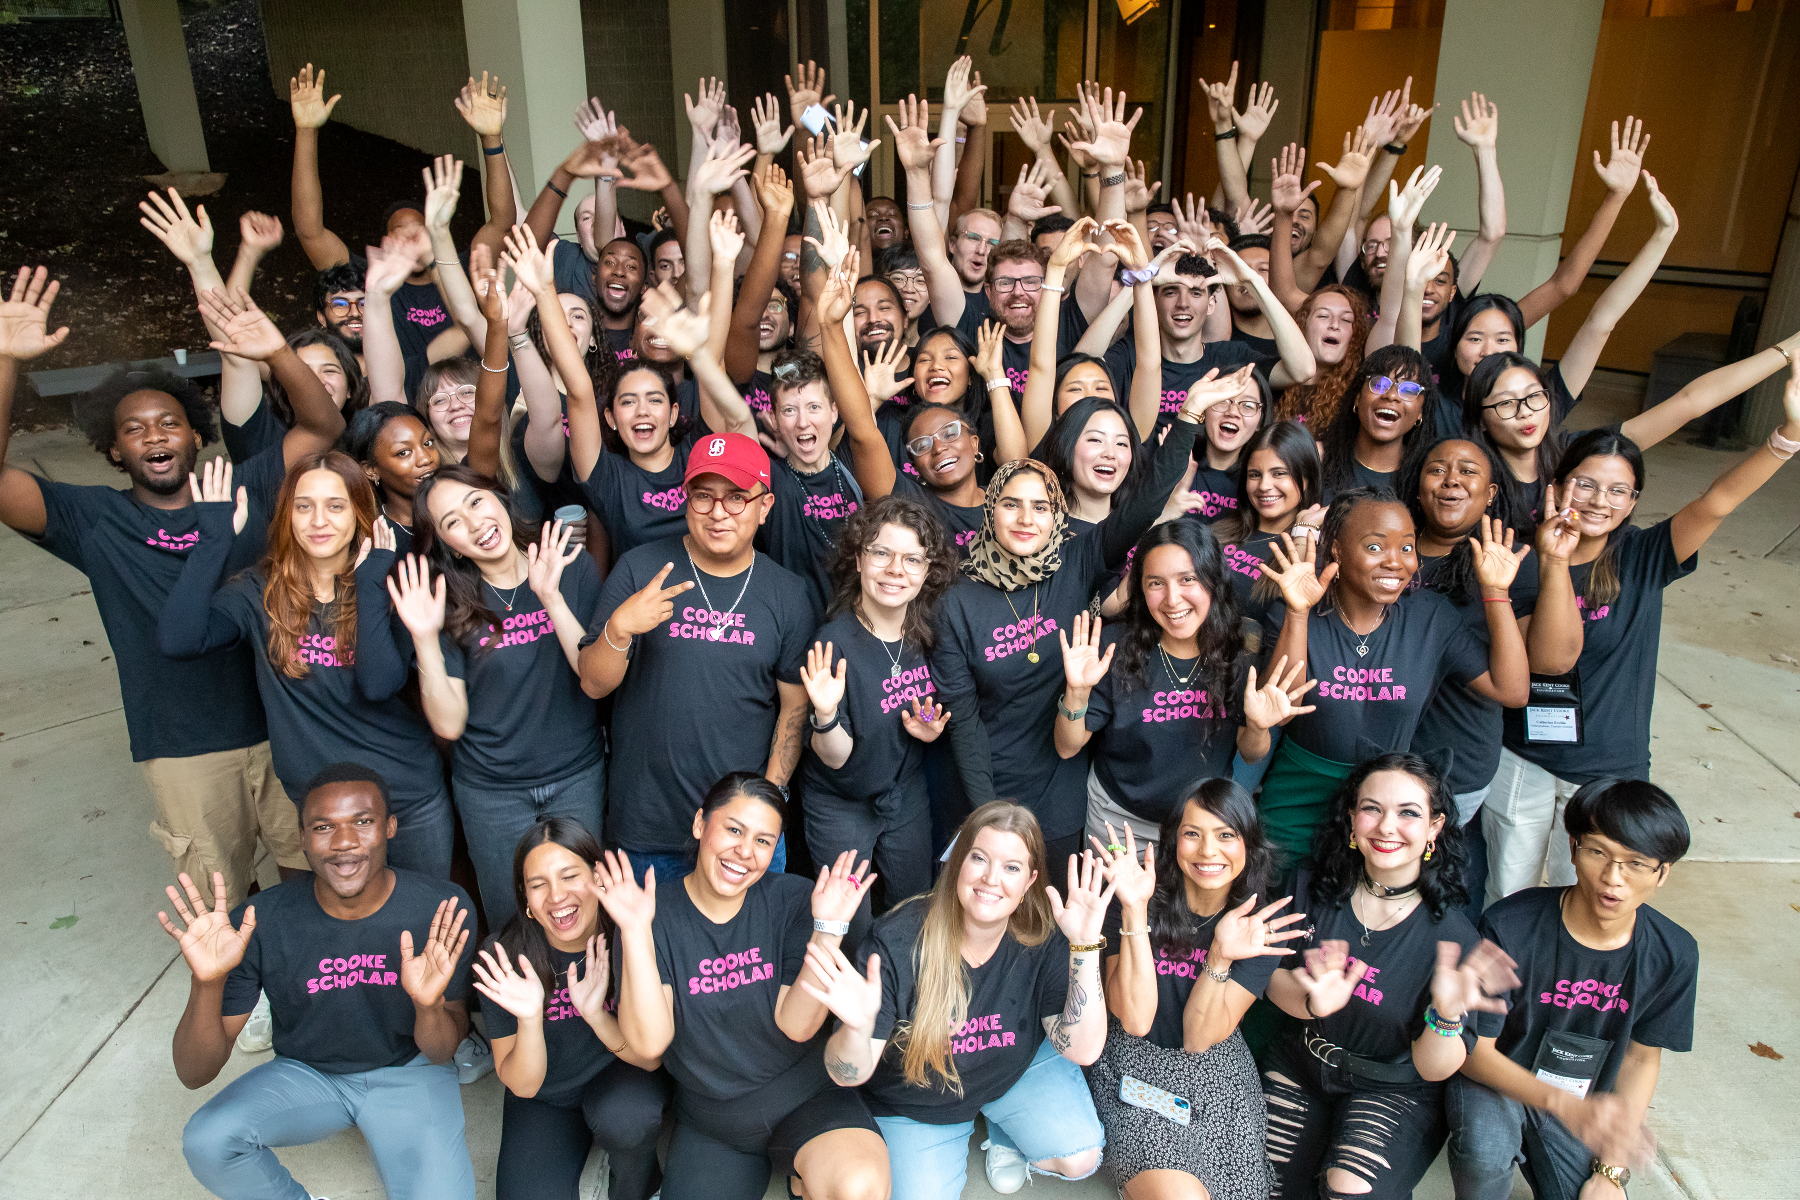
Key Dates
Application opens:
August 19, 2026 (Earlier date!!)
Application closes:
December 9, 2026 (Earlier date!!)
Semifinalists announced:
February 2027
Recipients announced:
May 2027

Slide 13
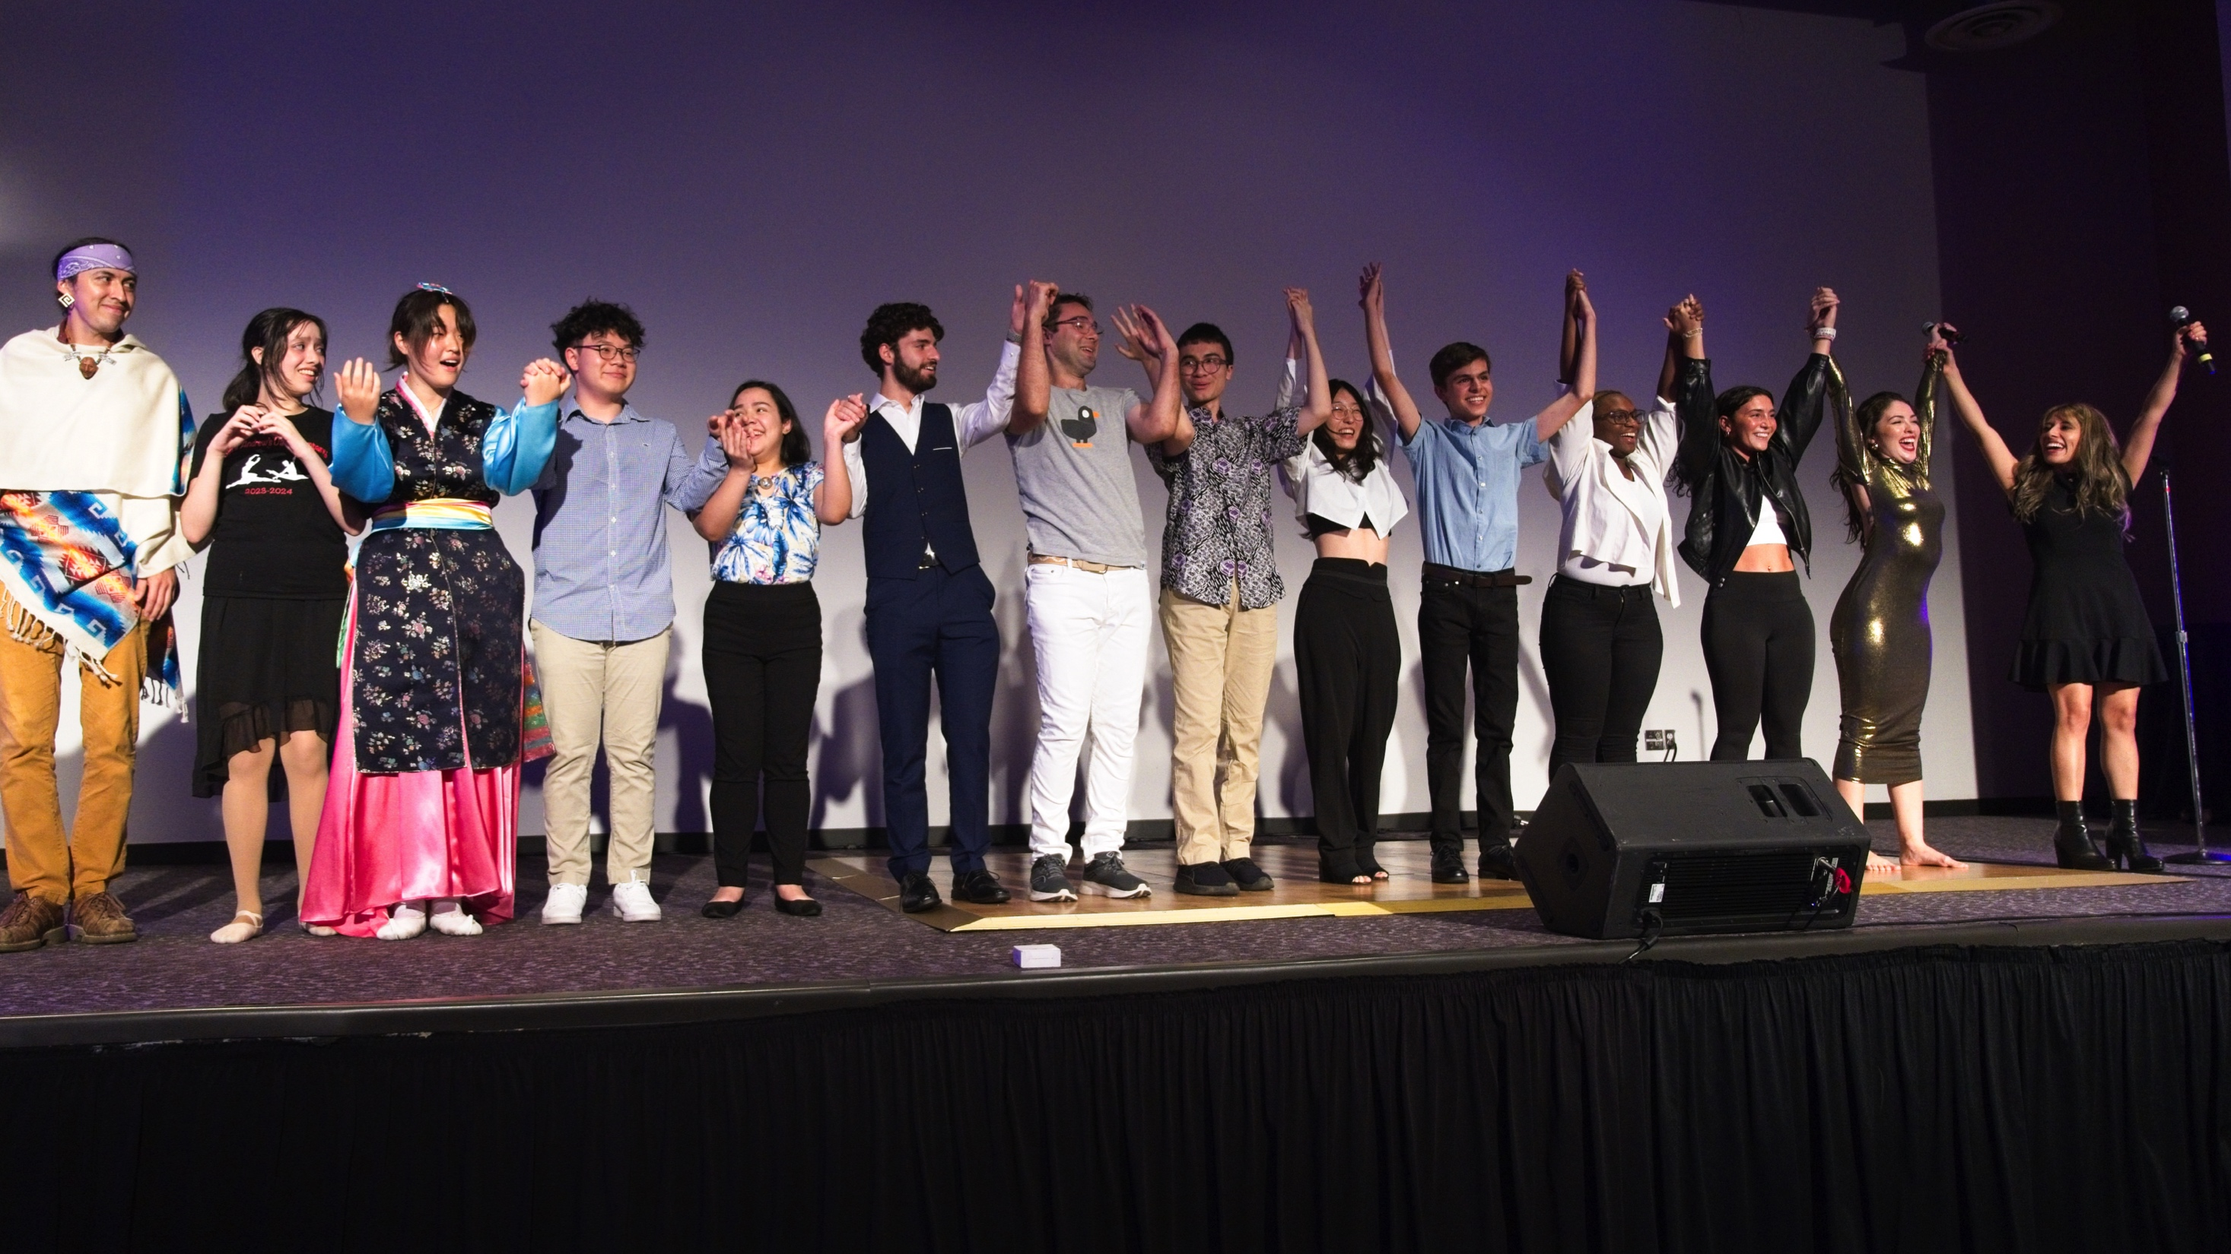
THANK YOU!

